Slide 1
Emerging Flux Simulations
Bob Stein
Lagerfjard
Å. Nordlund
D. Benson
D. Georgobiani

Slide 2
Numerical Method
Radiation MHD: solve conservation eqns. for mass, momentum, internal energy plus induction equation for magnetic field
Spatial derivatives: finite difference 6th order, 5th order interpolations
Time advance: 3rd order, low memory Runge-Kutta
Non-grey radiative transfer using 4 bin multi-group method with one vertical and 4 slanted rays (which rotate each time step)

Slide 3
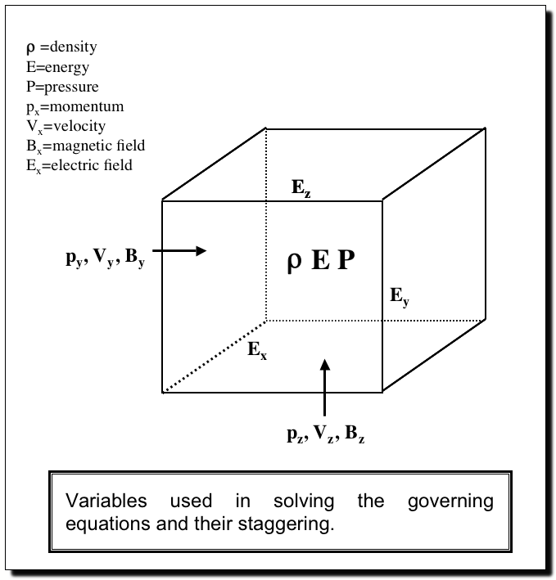
Numerical Method
Spatial differencing
  6th-order finite difference
  staggered
Time advancement
  3rd order Runga-Kutta
Equation of state
  tabular
  including ionization
  H, He + abundant elements
Radiative transfer
  3D, LTE
  4 bin multi-group opacity

Slide 4
Simulation set up
Vertical boundary conditions: Extrapolate lnρ; Velocity -> constant @ top, zero derivative @ bottom; energy/mass -> average value @ top, extrapolate @ bottom;
B tends to potential field @ top,
Horizontal B_{x0} advected into domain by inflows @bottom (20 Mm), 3 cases: B_{x0} = 10, 20, 40 kG
f-plane rotation, lattitude 30 deg
Initial state – non-magnetic convection.

Slide 5
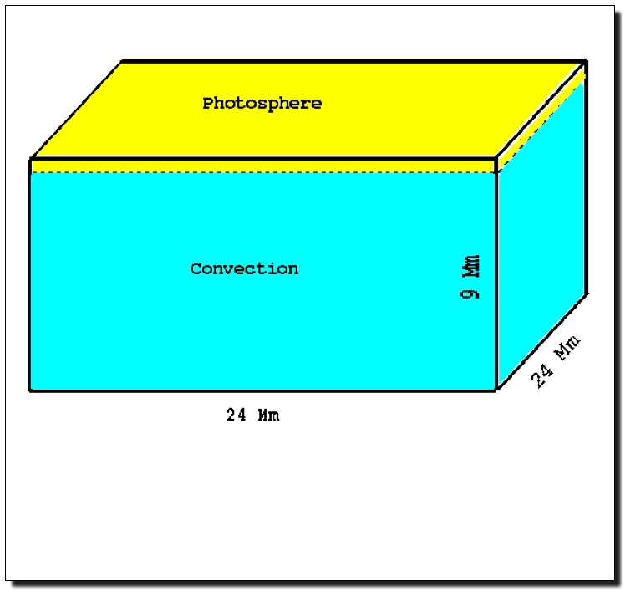
Computational Domain
20 Mm
48 Mm
48 Mm
Computational Domain for the CFD Simulations of Solar Convection
Notes:
125 million gps
surface is roughly 0.5 Mm below the upper boundary -- u.b. is at temperature minimum
BCs ? --
Top (lb): extrap log density, zero deriv velocity, energy per unit mass - slowly evolving average
Bottom(ub): extrap density, veloc symmetric,

Slide 6
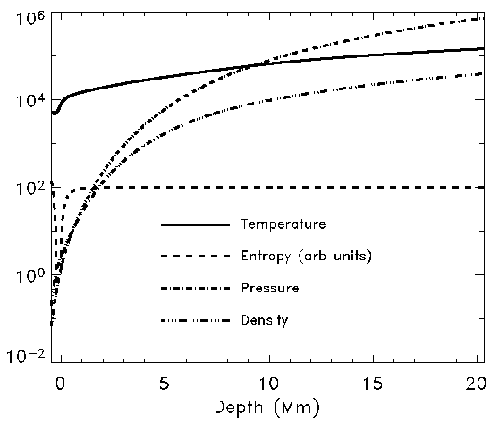
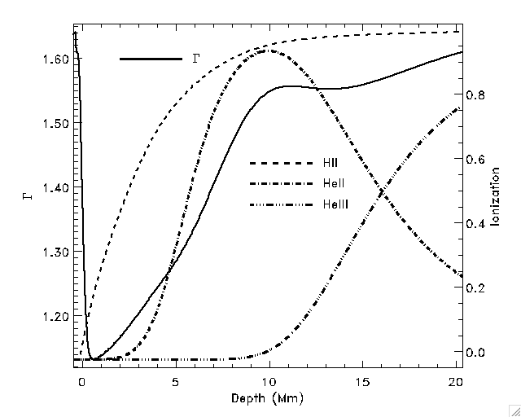
Mean Atmosphere

Slide 7
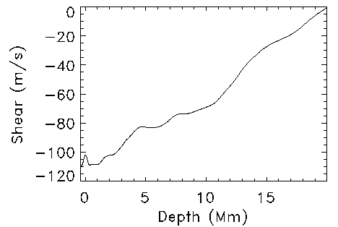
Surface shear layer f-plane rotation

Slide 8
Maximum |B| at 100 km below τ_{cont} = 1 (10kG)

Slide 9
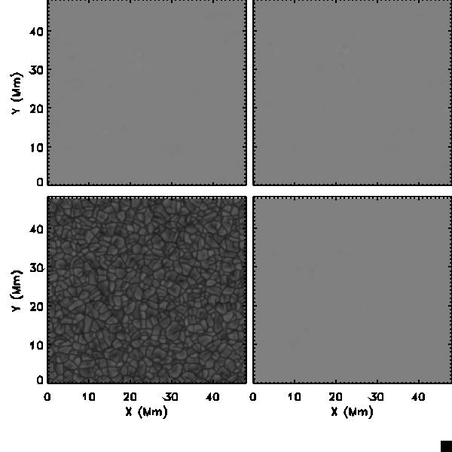
Flux
Emergence
(10 kG case)
15 – 40 hrs
Average fluid rise
time = 32 hrs
(interval between
frames 300 -> 30 sec)
B_{y} B_{x}
I B_{v}

Slide 10
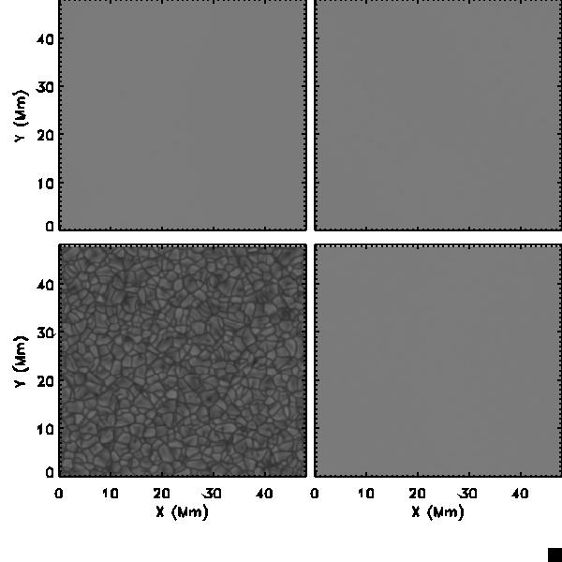
Flux
Emergence
(20 kG case)
15 – 22 hrs
Average fluid rise
time = 32 hrs
(interval between
frames 300 -> 30 sec)
B_{y} B_{x}
I B_{v}

Slide 11
20 kG
10 kG

Slide 12
Intensity &
B_{vertical}
Contours:
± 0.5,1.0,1.5 kG
10 kG case
Field is very
intermitent

Slide 13
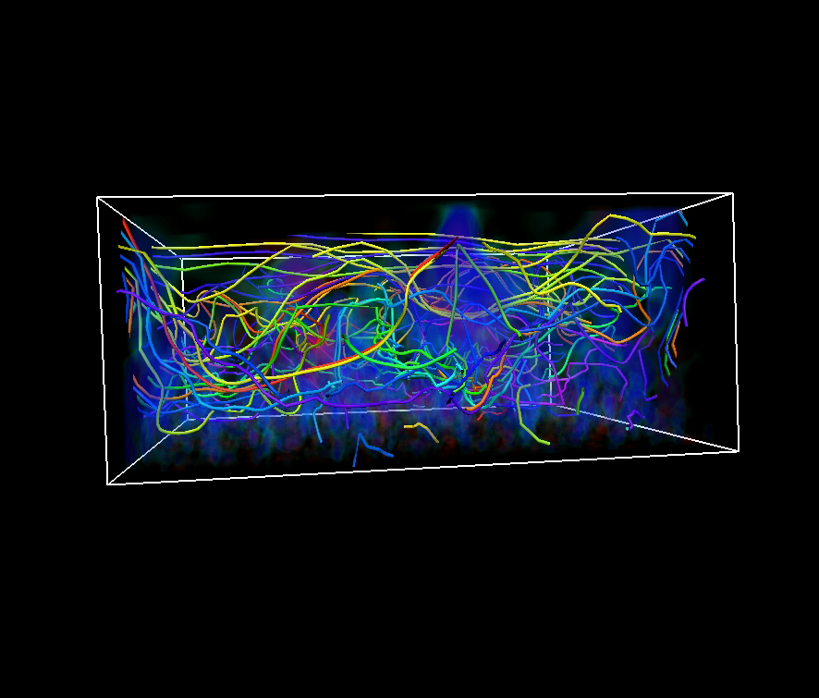
10 kG

Slide 14
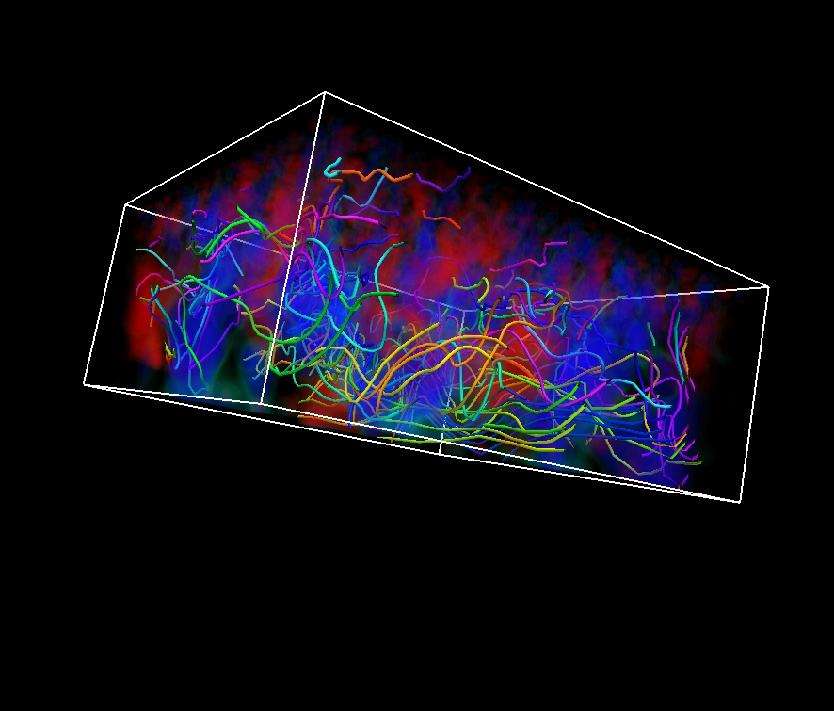
10 kG

Slide 15
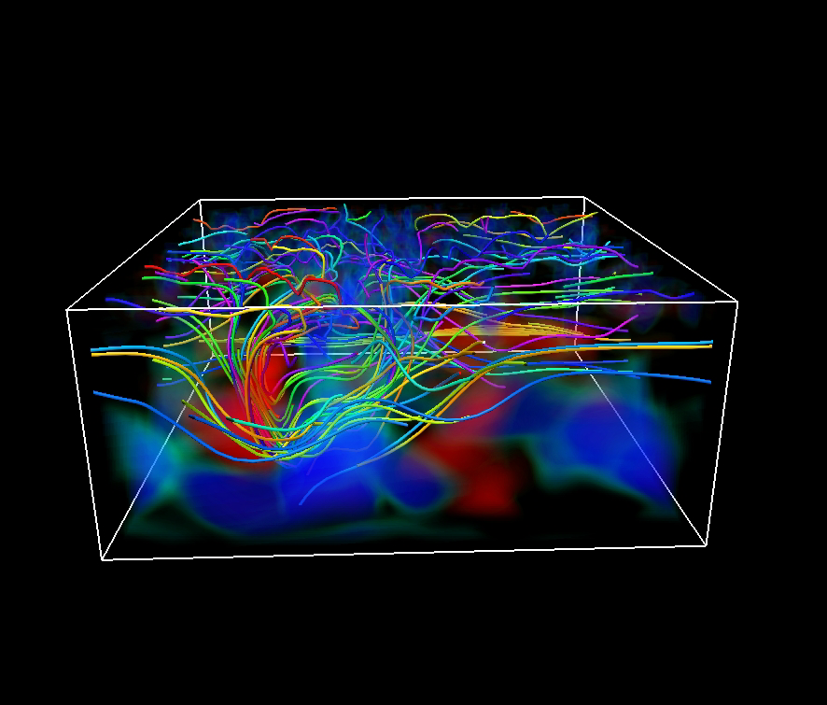
20 kG

Slide 16
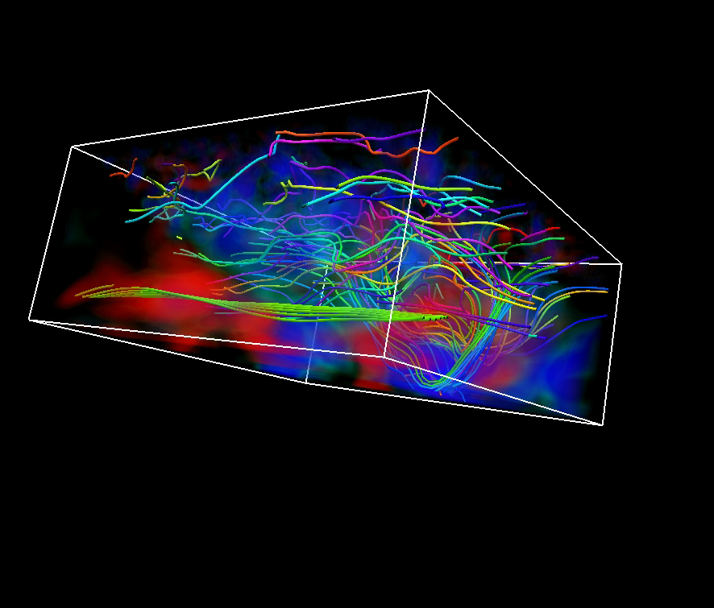
20 kG

Slide 17
10 kG
20 kG

Slide 18
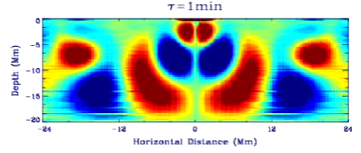
Waves exist in the simulation, generated by turbulent motions.
Sound waves are revealed by density fluctuations.
Non-magnetic case. Courtesy of Junwei Zhao

Slide 19
P-Mode ridges (20 kG case,4 hr sequence)
Magnetic contours
on non-magnetic image
Non-magnetic contours
on magnetic image
courtesy Dali Georgobiani

Slide 20
P-Mode ridges (40 kG case,4 hr sequence)
Magnetic contours
on non-magnetic image
Non-magnetic contours
on magnetic image
courtesy Dali Georgobiani

Slide 21
Status
Currently have 40 (10kG), 22 (20kG), 17 (40kG) hours, saved every 30 sec (except initially)
Generates 0.5 solar hour / week
Will produce slices of: emergent intensity, three velocity components, & temperature at several heights in the photosphere
Will produce 4 hour averages with 2 hour cadence of full chunks: temperature, density, 3 velocity components, 3 magnetic field components. pressure
After accumulate 12 solar hours will put on steinr.pa.msu.edu/~bob/mhdaverages

Slide 22
Questions:
Currently rising magnetic flux is given the same entropy as the non-magnetic plasma, so it is buoyant. What entropy does the rising magnetic flux have in the Sun? Need to compare simulations with observations for clues.
What will the long term magnetic field configuration look like? Will it form a magnetic network? Need to run for several turnover times (2 days).
What is the typical strength of the magnetic field at 20 Mm depth? Again, need to compare long runs with observations for clues.

