Slide 1
Emerging Flux Simulations
& proto Active Regions
Bob Stein – Michigan State U.
Lagerfjärd – Copenhagen U.
Å. Nordlund – Niels Bohr Inst.
D. Georgobiani – Michigan State U.

Slide 2
The Simulation
Advect minimally structured magnetic field -- horizontal, uniform, untwisted – by inflows at bottom
Complement simulations of coherent, twisted flux tube emergences
Objectives:
  Investigate formation and structure of sunspots without
  ad hoc boundary conditions
  Provide synthetic data for validating local helioseismology and vector magnetograph inversion procedures
  Investigate nature of supergranulation

Slide 3
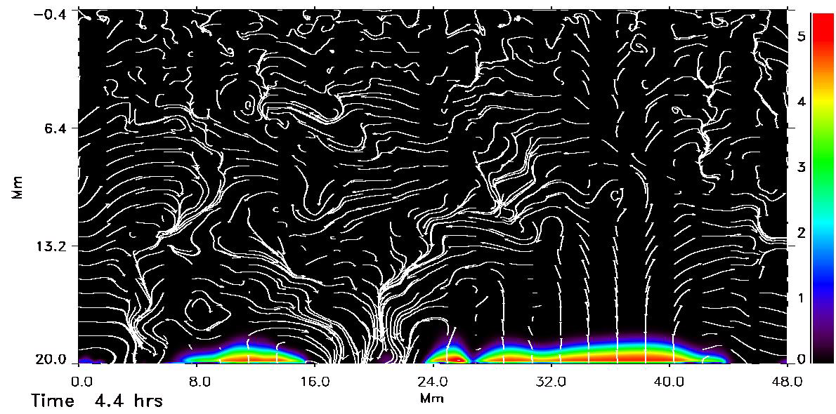
Emerging Magnetic Flux
ΙBΙ & Velocity

Slide 4
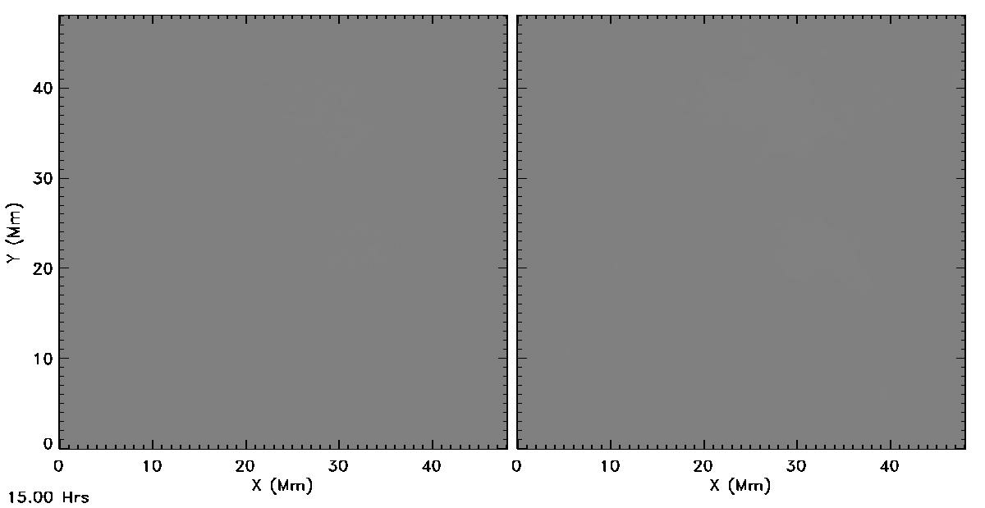
Flux Emergence
20 kG @ 20 Mm depth @ 30º to x-axis, 15 – 32 hrs
Average fluid rise time = 32 hrs (interval between frames =1 min)
96 km horizontal resolution -> 48 km
B_{v}
B_{h}

Slide 5
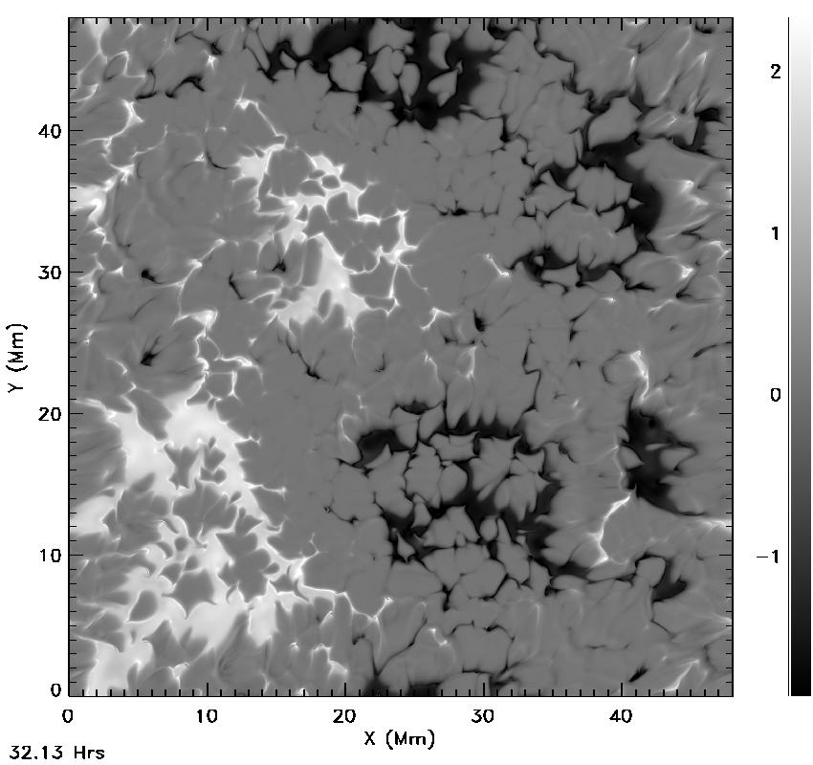
Vertical
Magnetic
Field
Pore/Spot Development
(20 kG case)
32.1-35.1 hrs
(interval between
frames =1 min)
Horizontal resolution
24 km.

Slide 6
Global magnetic structure

Slide 7
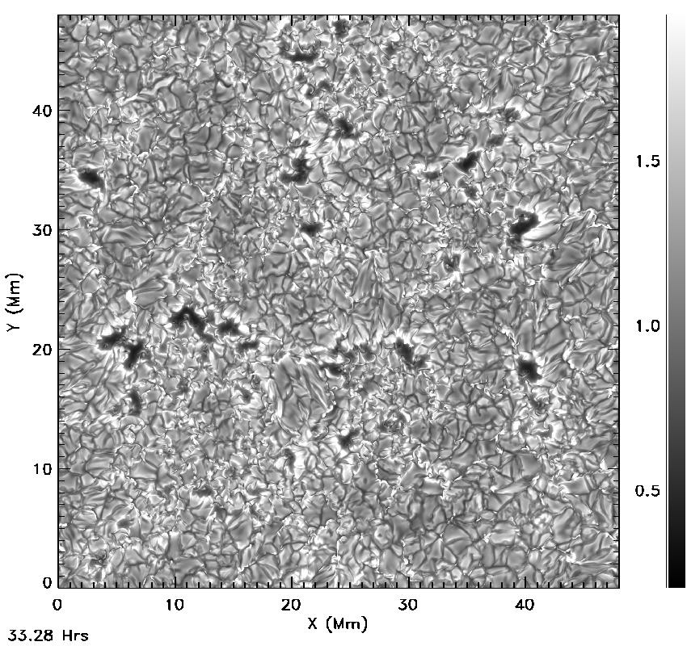
Emergent
Intensity,
I/<I>
Flux
Emergence
(20 kG case)
33.3-35.1 hrs
(interval between
frames =1 min)
Horizontal resolution
24 km.

Slide 8
Vertical Velocity (blue/green up, red/yellow down) & Magnetic Field lines
(slice at 5 Mm)
weak & horizontal B
-> normal granulation
vertical B ->
velocity suppression
weak & horizontal B
-> normal granulation

Slide 9
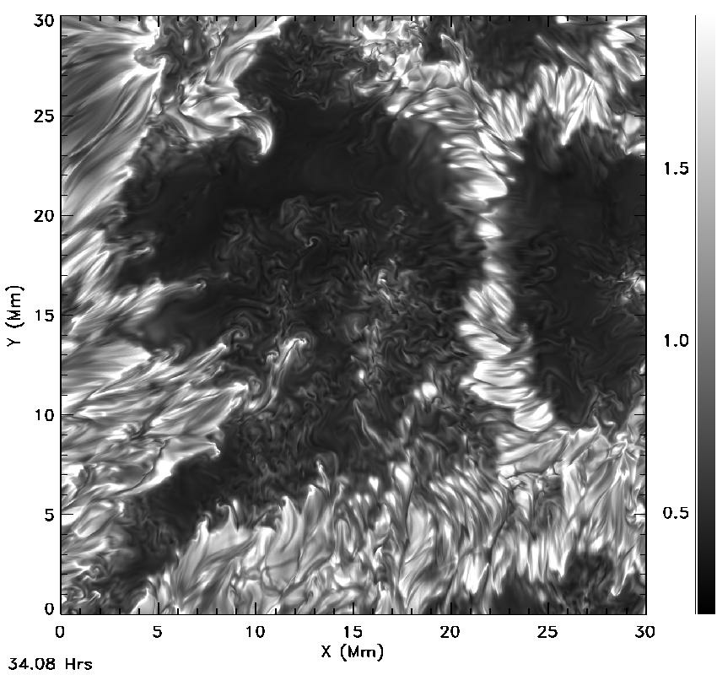
Proto-Spot 1 Evolution
Flux increase has
stopped,
~1x10¹⁹ Mx
in this spot

Slide 10
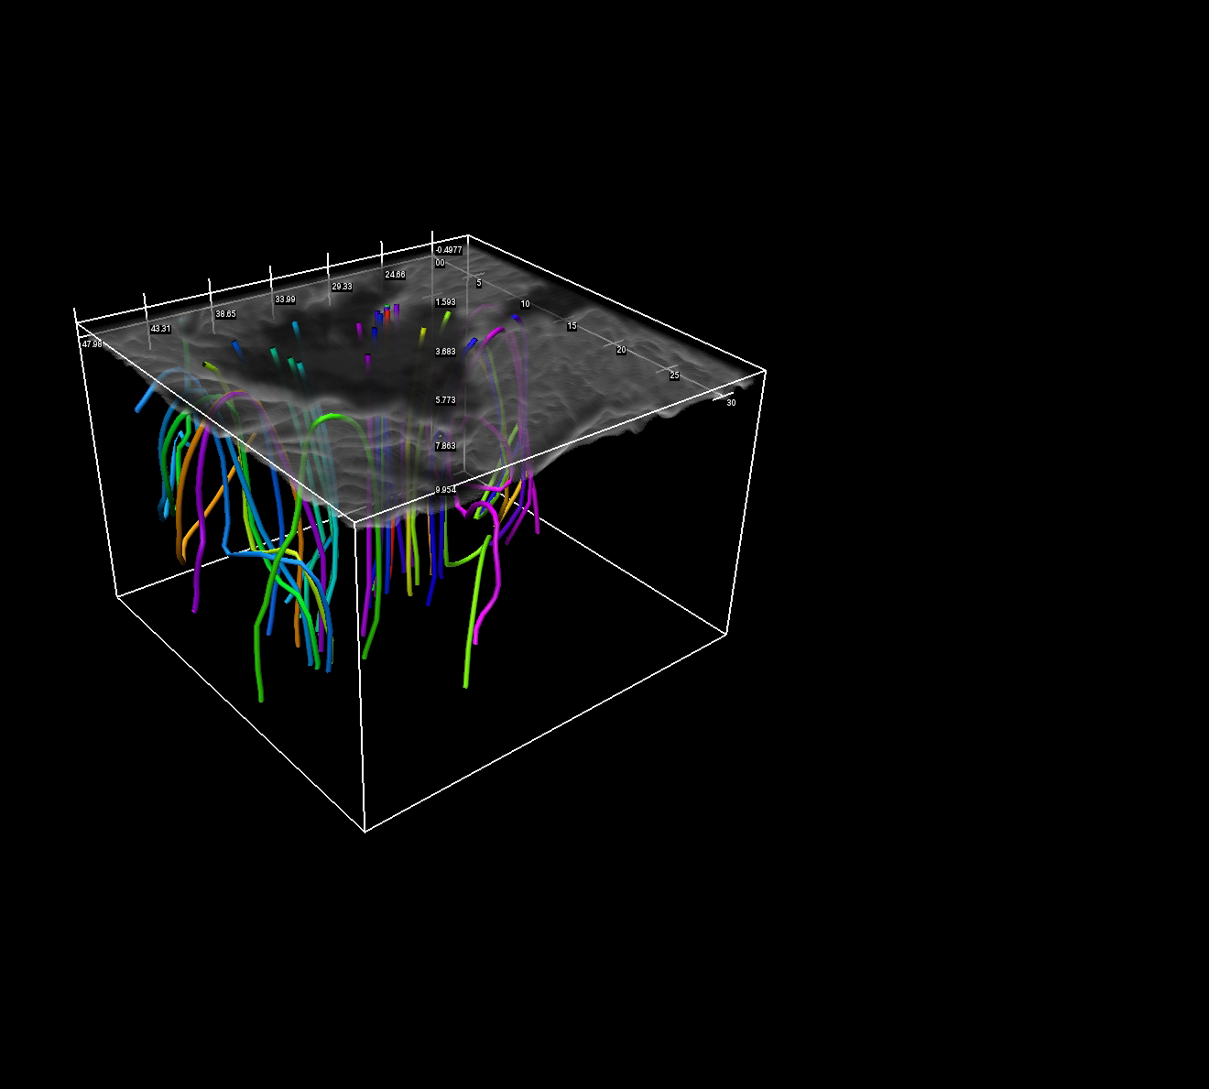

Slide 11
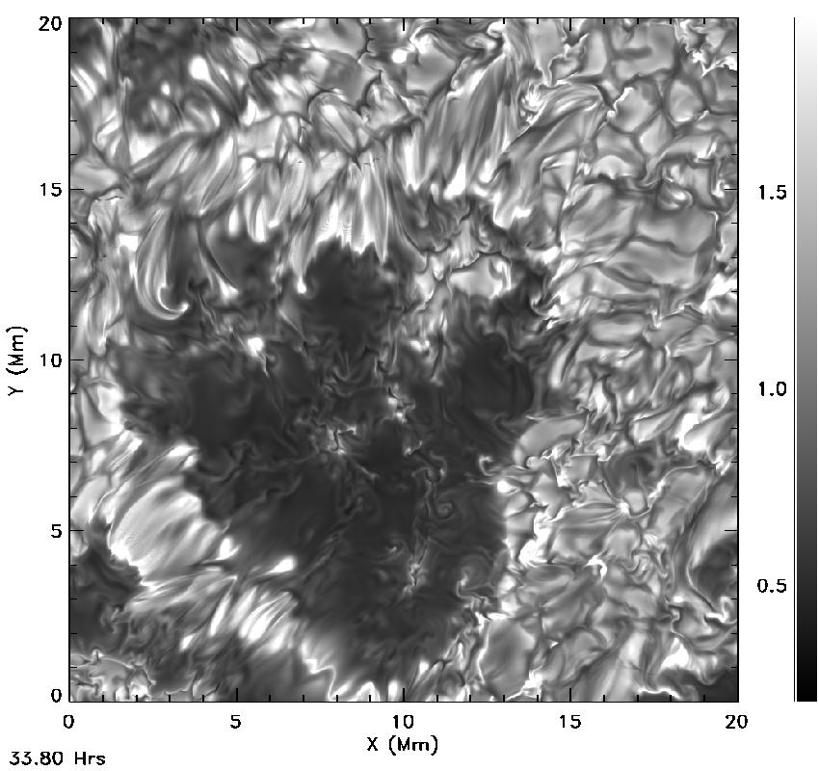
Proto Spot 2

Slide 12
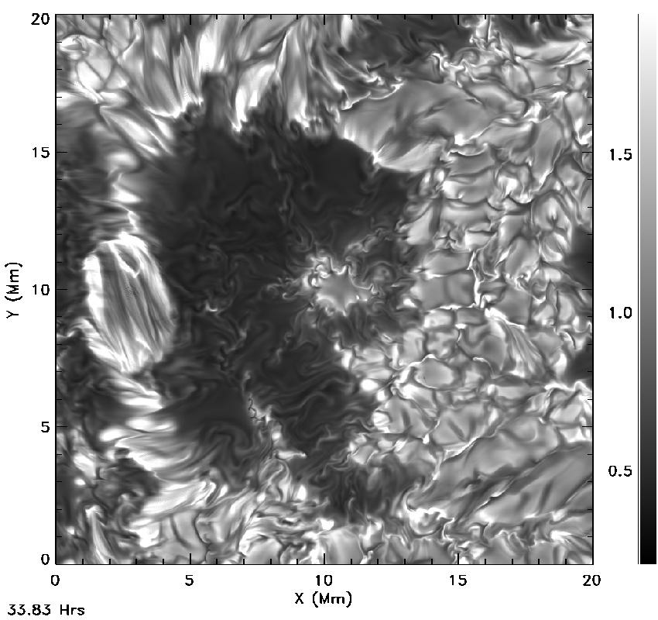
Proto Spot 3 disappearing

Slide 13
Intensity +
B_{vertical}
-2.5 blue, -2 green,
2 yellow,2.5 red
(kG)

Slide 14
V: simulation (left) & Hinode psf (right)
(6302.4 - 6302.6)

Slide 15
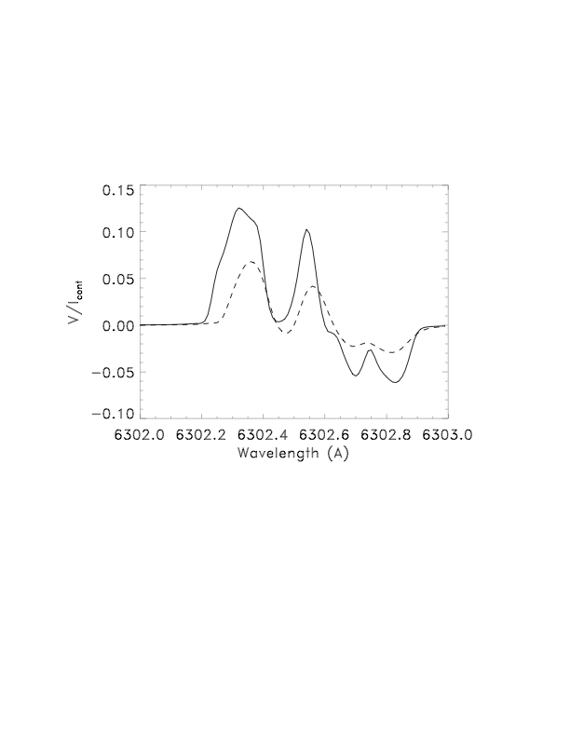
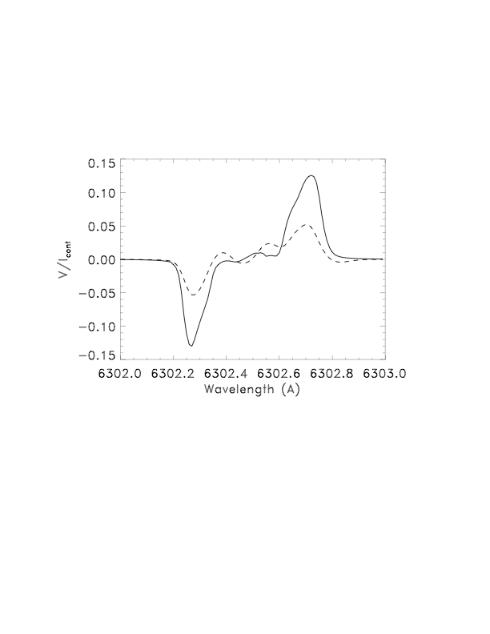
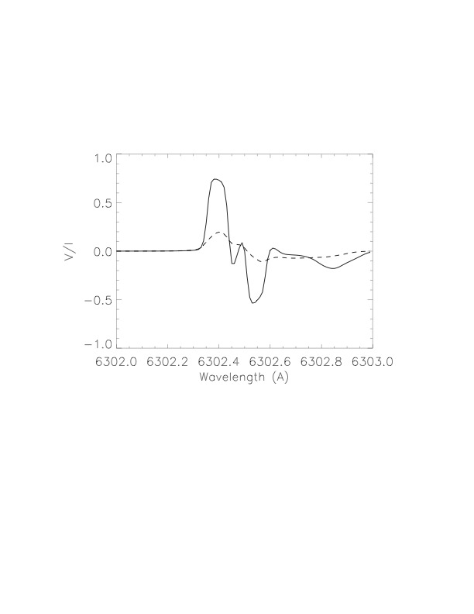
V line profiles from LILIA solid=raw, dashed = + psf

Slide 16
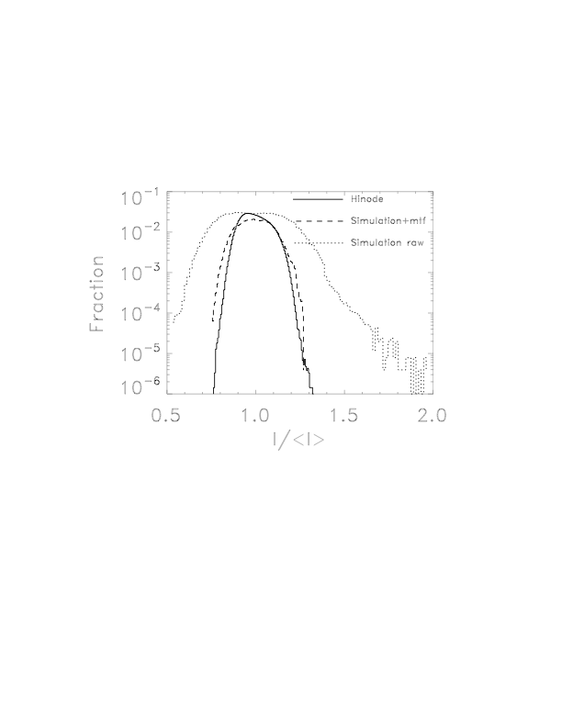
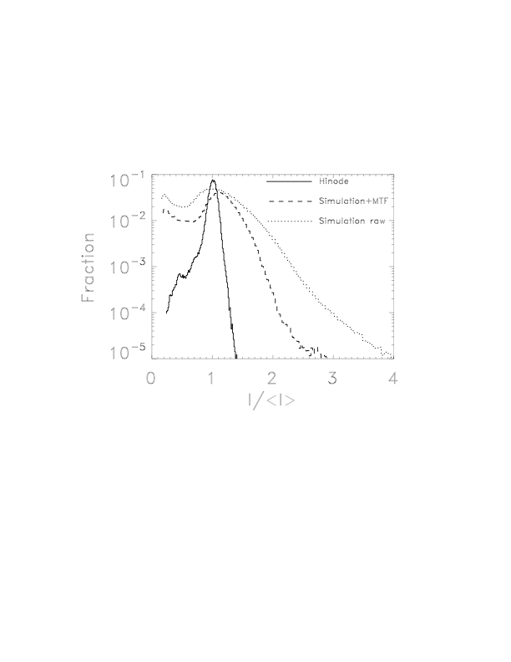
Intensity Distribution
Active Region
Quiet Sun

Slide 17
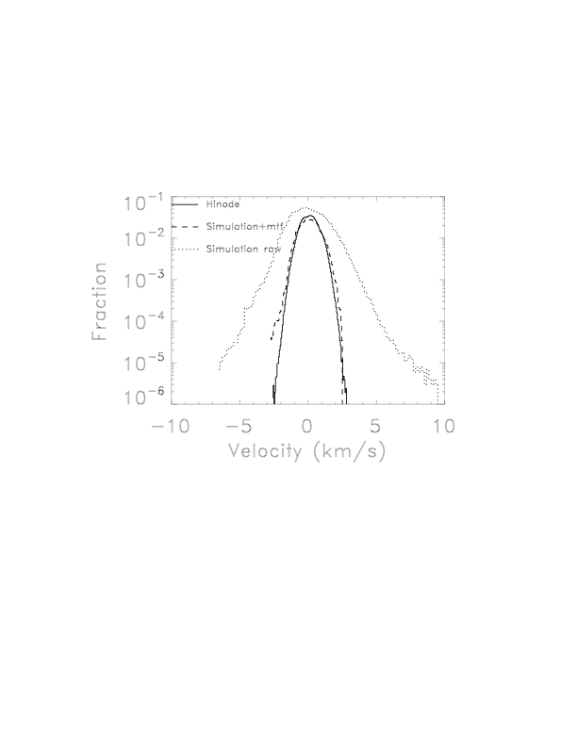
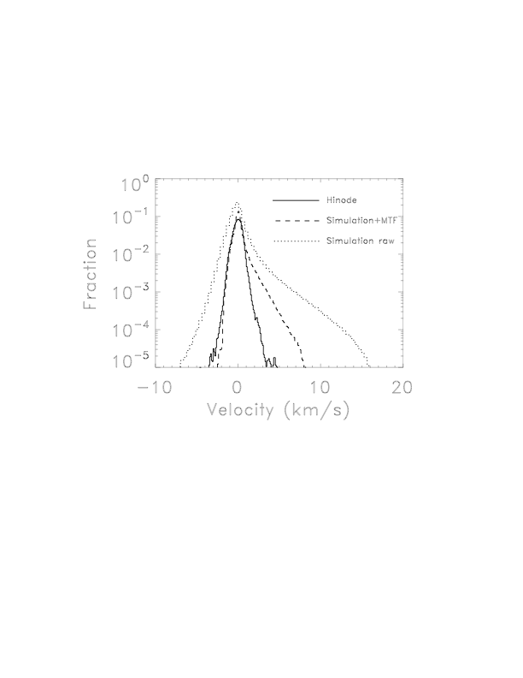
Velocity Distribution
Quiet Sun
Active Region

Slide 18
Location of Stokes Data
steinr.pa.msu.edu/~bob/stokes
Simulation results for
AR & QS: B, V
Stokes profiles: I,Q,U,V
  + Hinode annular mtf
  + slit diffraction
  + frequency smoothing

