Slide 1
Solar ACTIVE REGION MAGNETOCONVECTION
& SUNSPOTS
Åke Nordlund & Anders Lagerfjärd
Niels Bohr Institute, Copenhagen
Bob Stein
Dept. of Physics & Astronomy, MSU, East Lansing

Slide 2
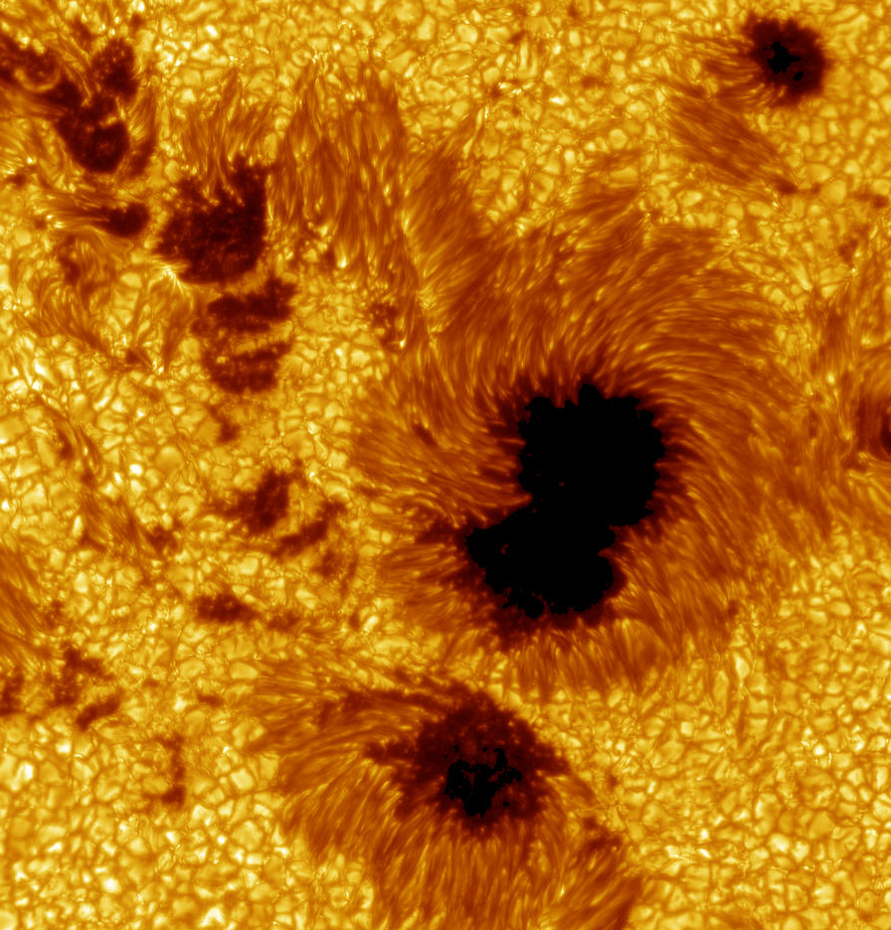
Fundamental Questions
What is the (still un-observed) structure of sunspots?
  Sub-resolution surface structure?
  Sub-surface structure?
What controls their birth,
evolution, and decay?
How do they fit into
a larger context?
Notes:
Important points to make:

Slide 3
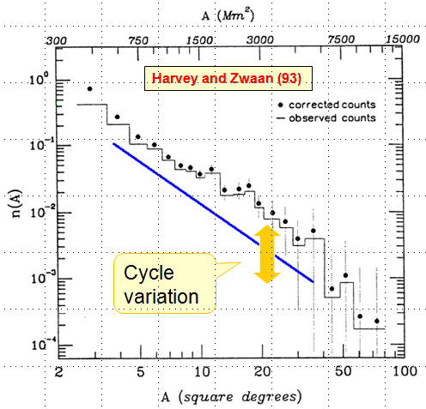
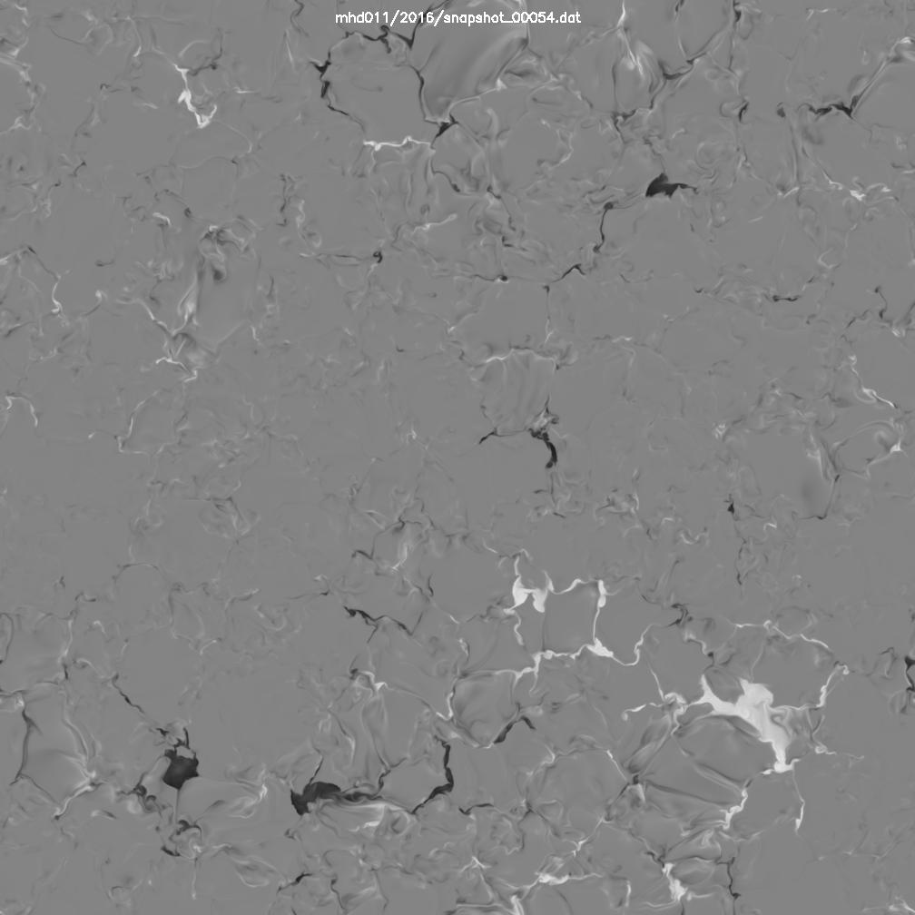
Sunspots in a Context
Sunspots and active regions represent only the top of the iceberg!
They are just the largest flux concentrations in a power law distribution of emerging magnetic flux
Complex spatial distribution of magnetic flux extends also to ’Quiet Sun’ (misnomer)
Notes:
Important points to make:

Slide 4
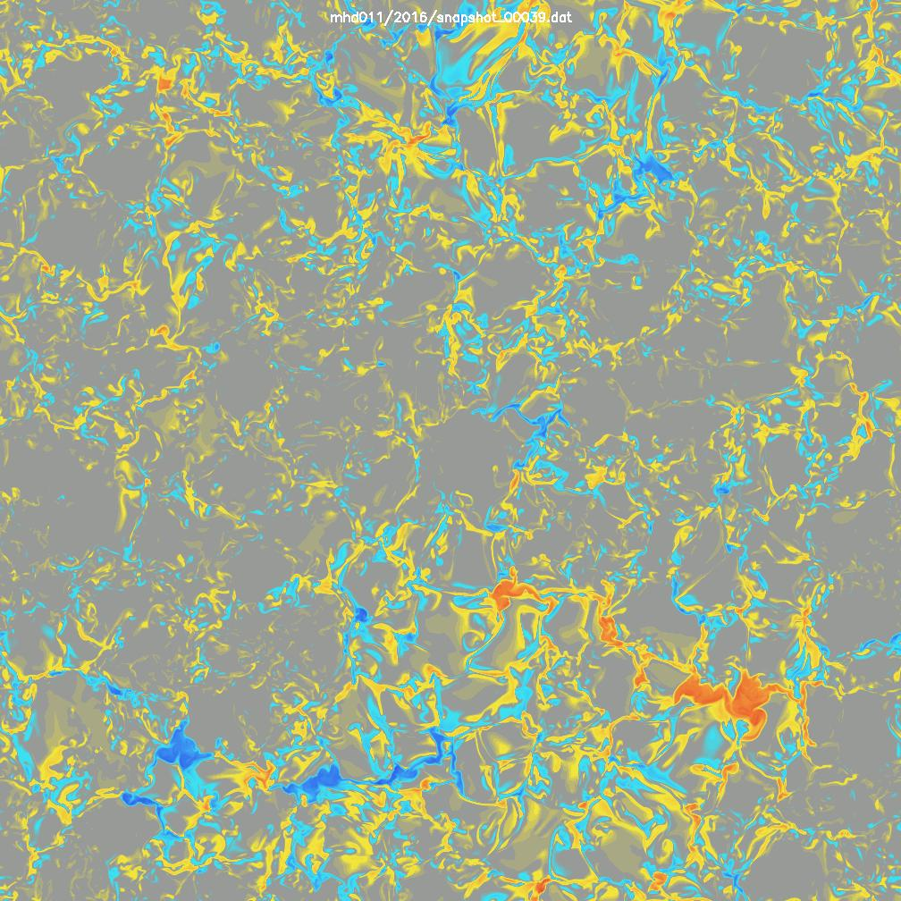
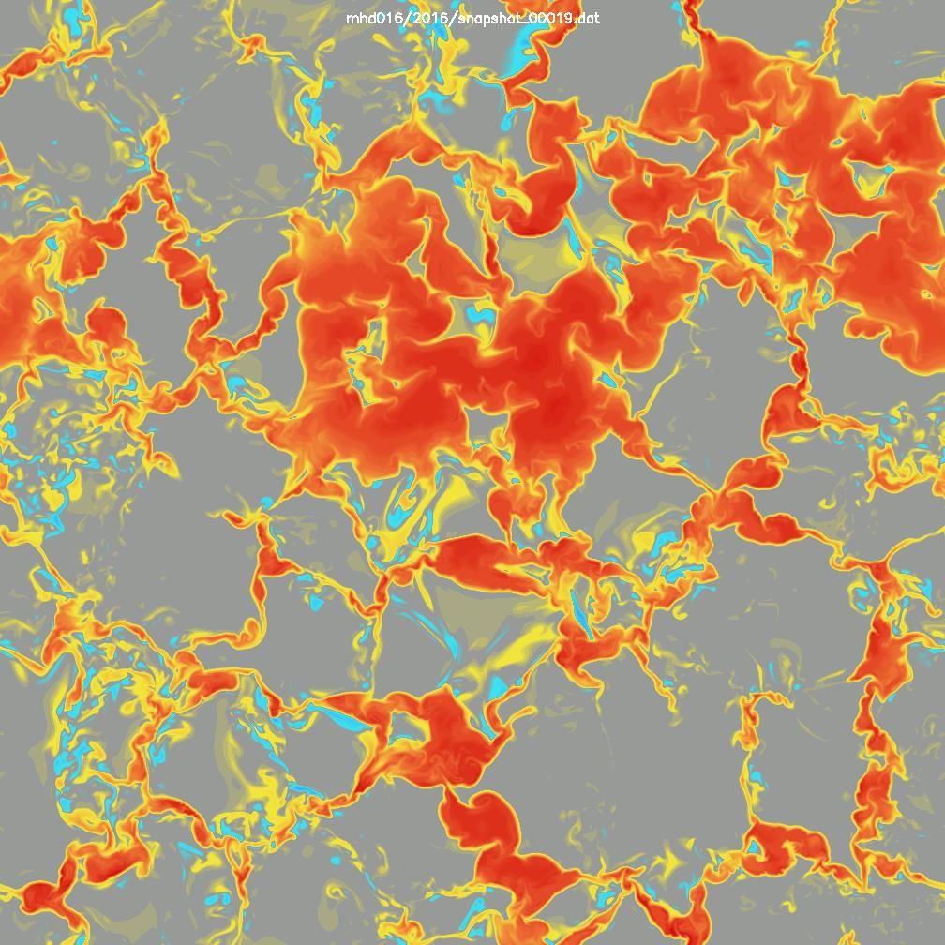
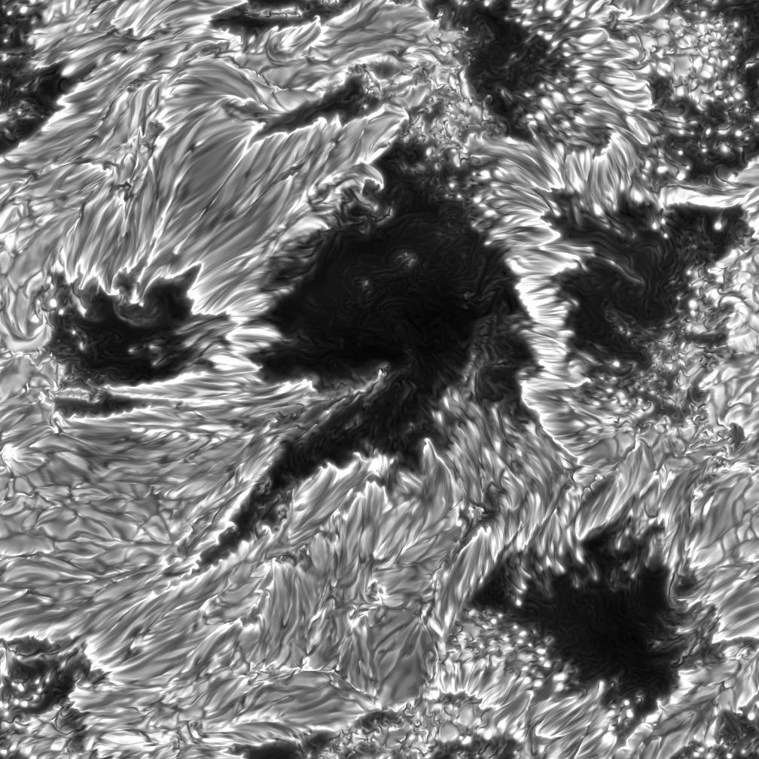
Simulations to be shown
’Quiet’ Sun
  48x48x20 Mm simulation boxes
    grid sizes down to 10 km vertically,
    24 km horizontally
  Zero mean field with <B²>^{1/2} ~ 50 – 150 G
Plage Region
  24x24x20 Mm simulation boxes
    grid sizes down to 6 km
  Mean vertical field B ~ 600 G
Active Region with Sunspots
  48x48x10 Mm simulation box,
  horizontal grid size 24 km
  Zero mean field with <B²>^{1/2} ~ 1.5 G

Slide 5
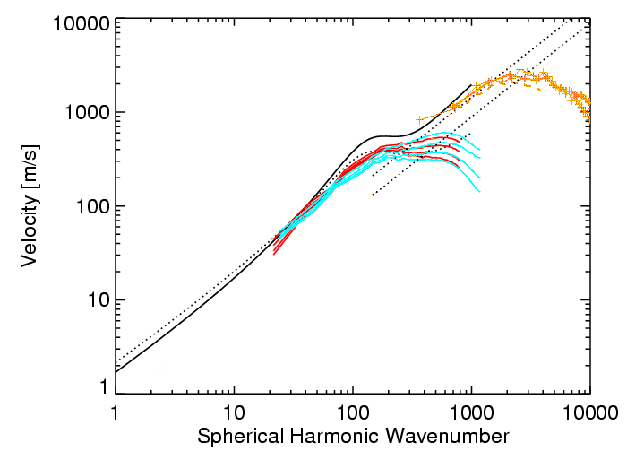
Solar ‘velocity spectrum’
3-D simulations (Stein & Nordlund)
“granulation”
V~k^{-1/3}
MDI correlation tracking (Shine)
Velocity spectrum:
v(k) = (k P(k))^{1/2}
“supergranulation”
“mesogranulation”
MDI doppler (Hathaway)
TRACE correlation tracking (Shine)
V ~ k

Slide 6
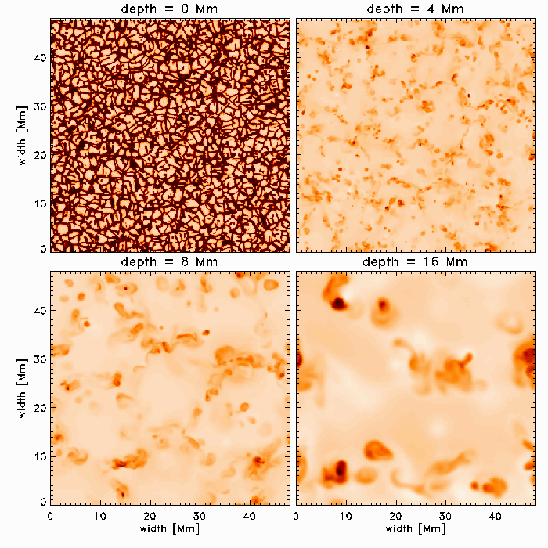
Convective scale hierarchy, T(x,y;t) at depths 0, 4, 8 & 16 Mm

Slide 7
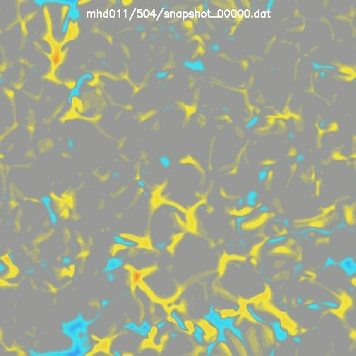
Magneto-convective scale hierarchy
(PhD project: Anders Lagerfjärd, NBI/Cph)
24²x20 Mm simulation box
  Up to 2016²x500 grid size
  Initially zero magnetic field, hierarchical convection
  A 1 kG horizontal field enters
  through the bottom
Spontaneously develops a multi-scale, ~self-similar magnetic field
  Structure development followed for ~ 30h solar time at 252²x500
  Emergence studied for
    ~ 3h at 504²x500,
    ~1h at 1008²x500
    ~15m at 2016²x500

Slide 8
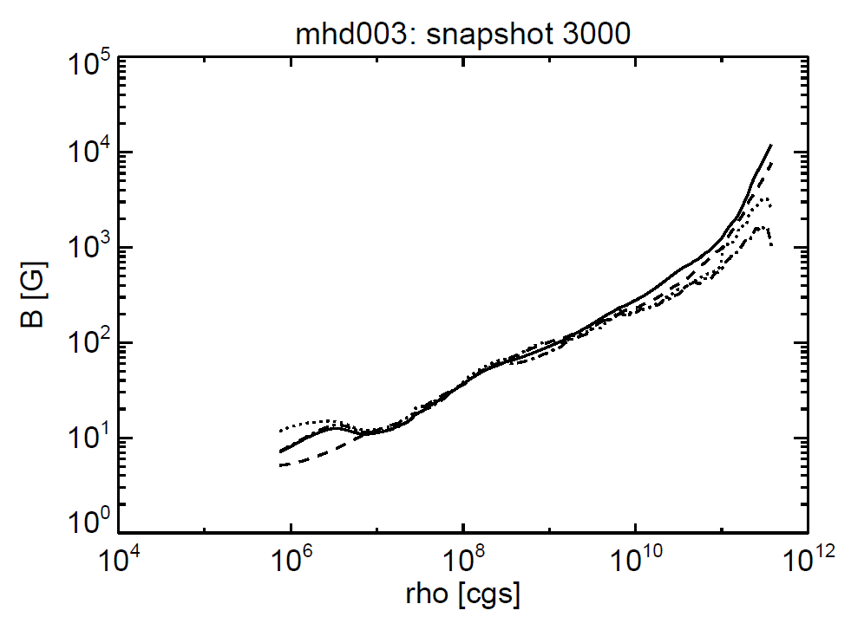
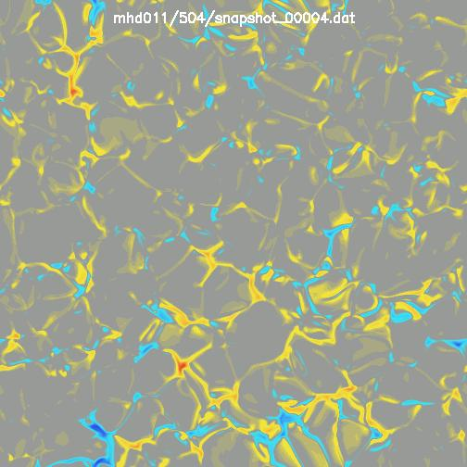
’Quiet’ Sun Magnetic Flux Emergence
Vertical transport ⇒ scaling of magnetic field fluctuations with depth
  B_{rms} ~ ρ^{1/2}
Spontaneous creation of
a hierarchy of emerging magnetic flux structures
  Even though the boundary condition injects a smooth magnetic field!
slope = ½

Slide 9
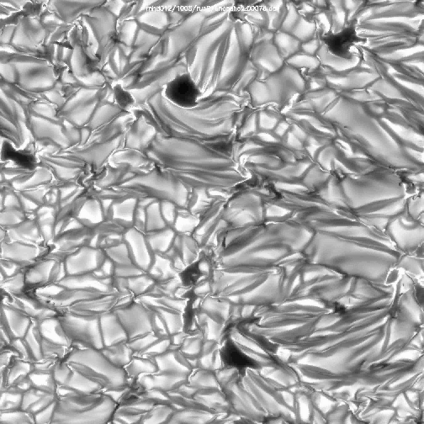
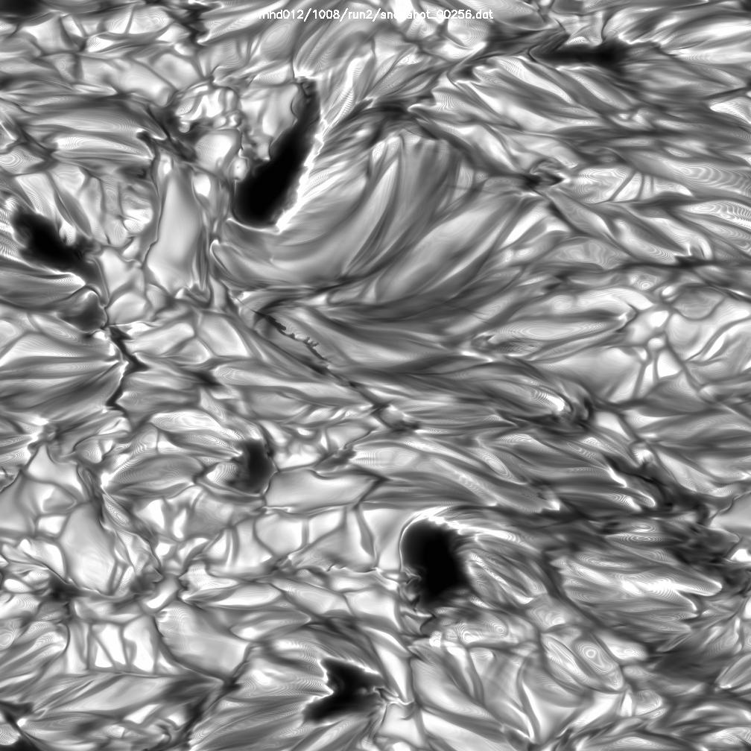
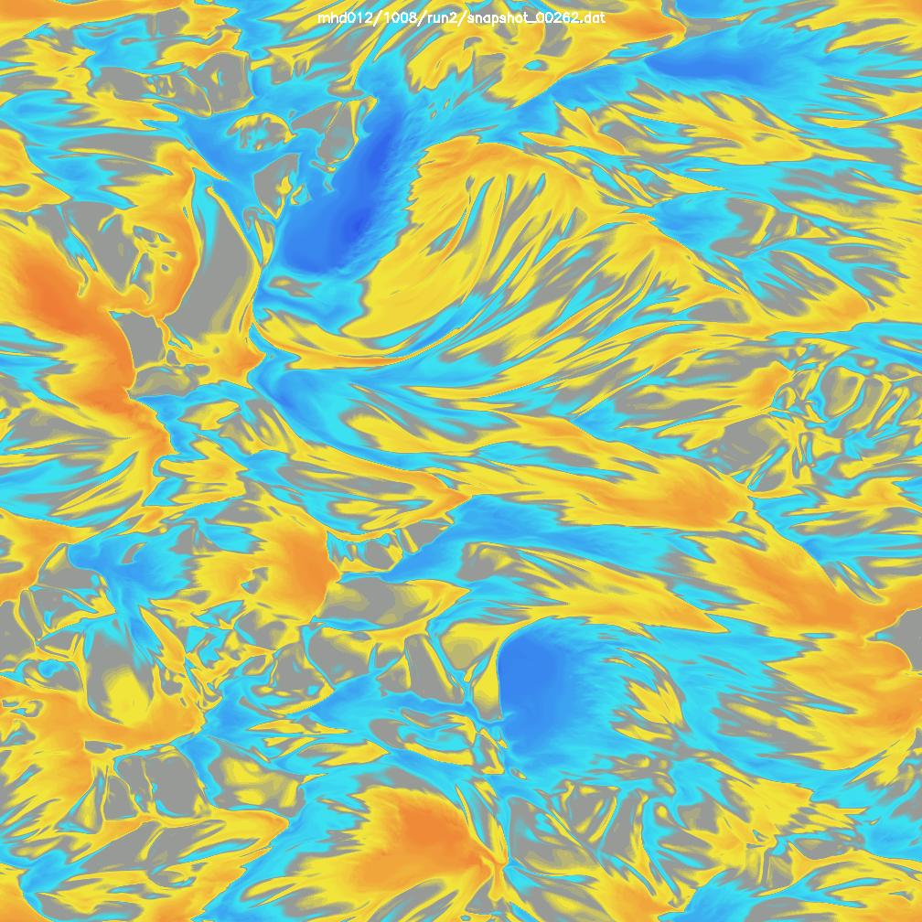
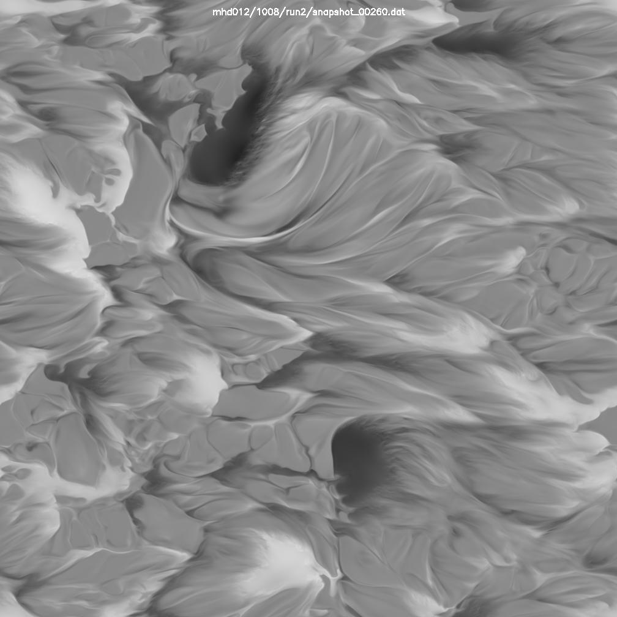
Larger injected flux density
⇒ larger field strength at the surface
Here’s another case:
24²x20 Mm simulation box
  Up to 2016²x500 grid size
  A 3 kG horizontal field enters
  through the bottom
  Initially prefilled magnetic field, consistent with density scaling
Pre-filling the simulation box speeds up development of the hierarchical magnetic field
  Structure development followed for ~ 8h solar time at 504²x500
  Emergence studied for
    ~2h at 1008²x500
    ~15m at 2016²x500

Slide 10
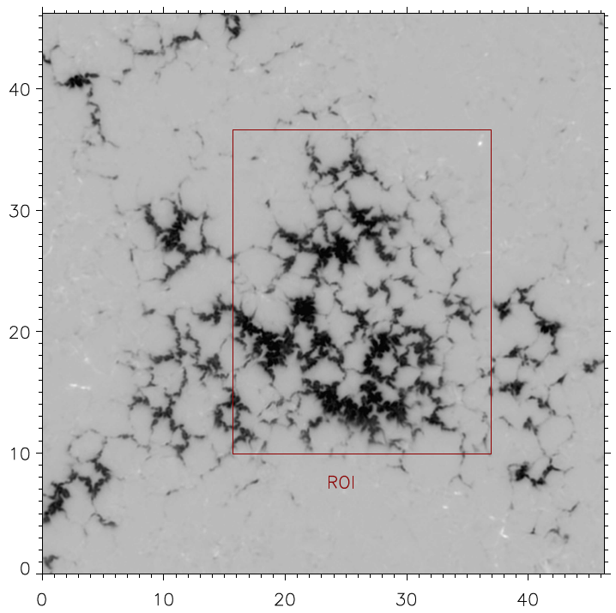
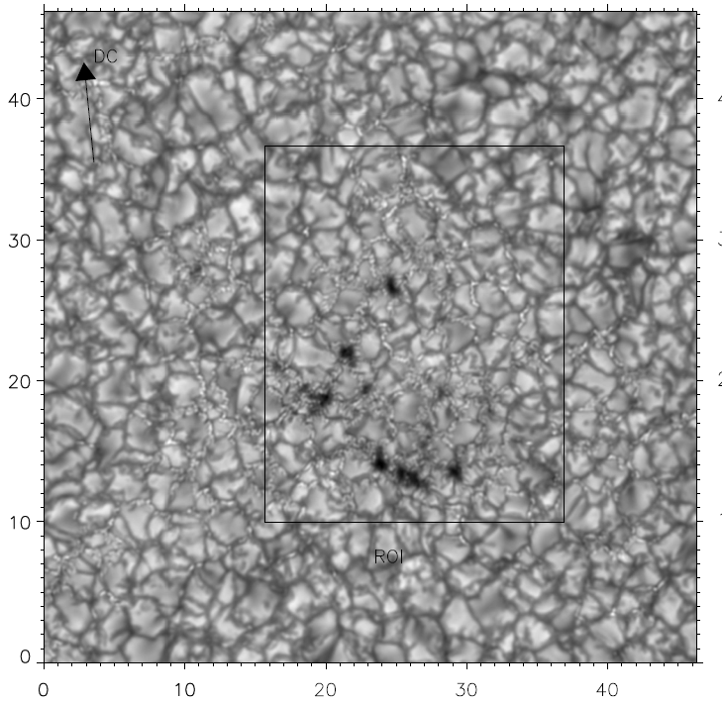
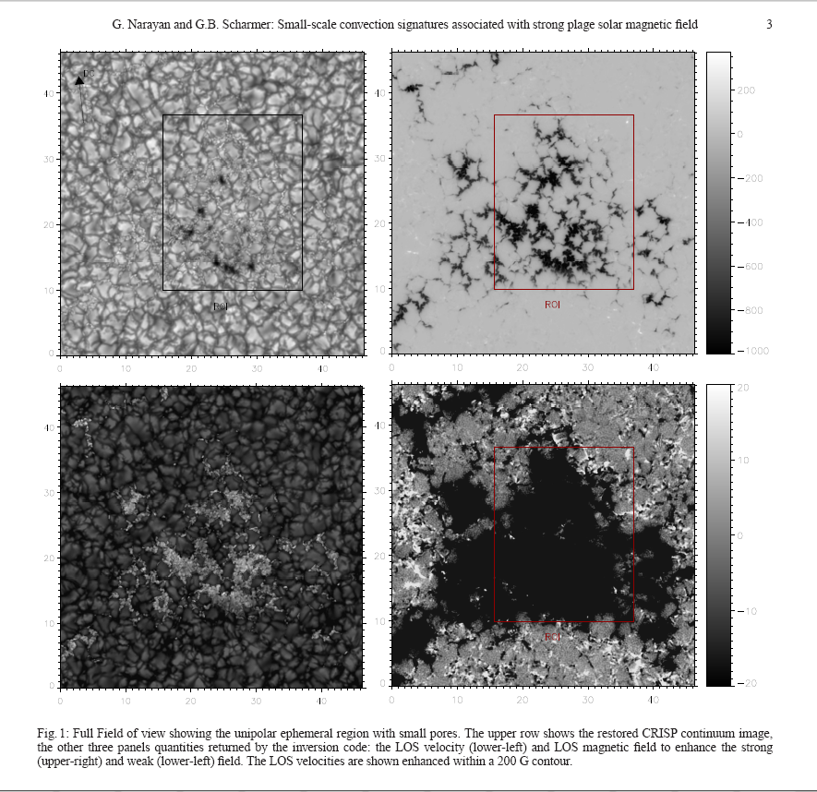
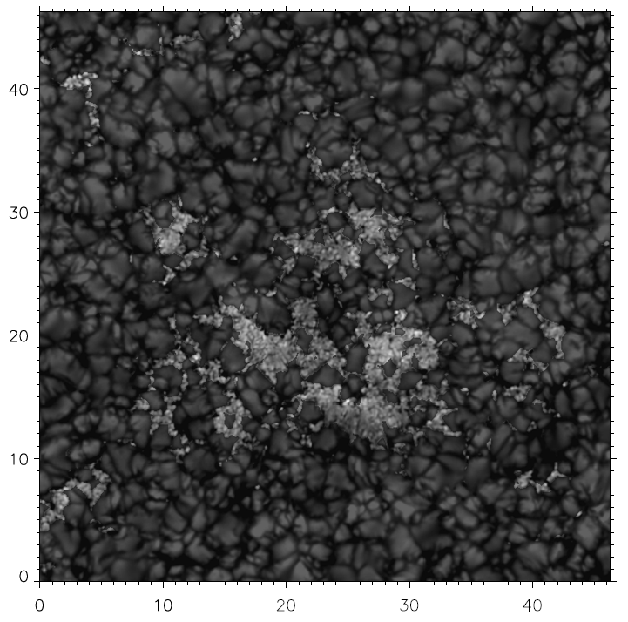
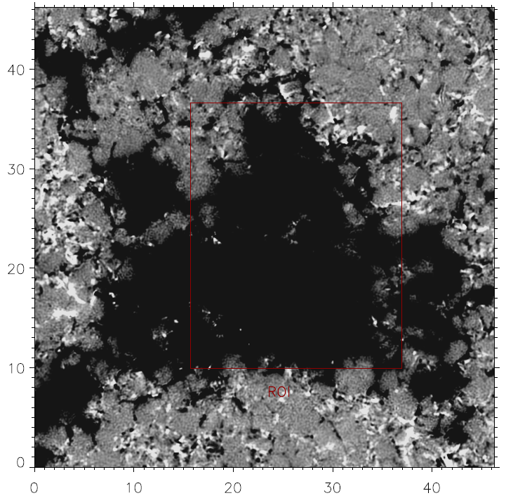
SST/CRISP observations by Narayan & Scharmer (arXiv:2010)
Continuum intensity
Strong magnetic field
Line-of-sight velocity
Weak magnetic field
B > 200 G mask with enhanced contrast

Slide 11
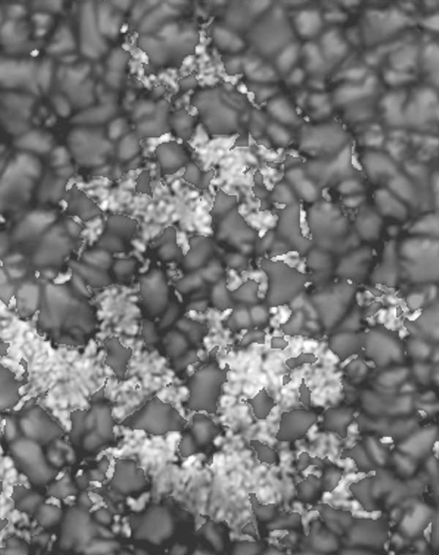
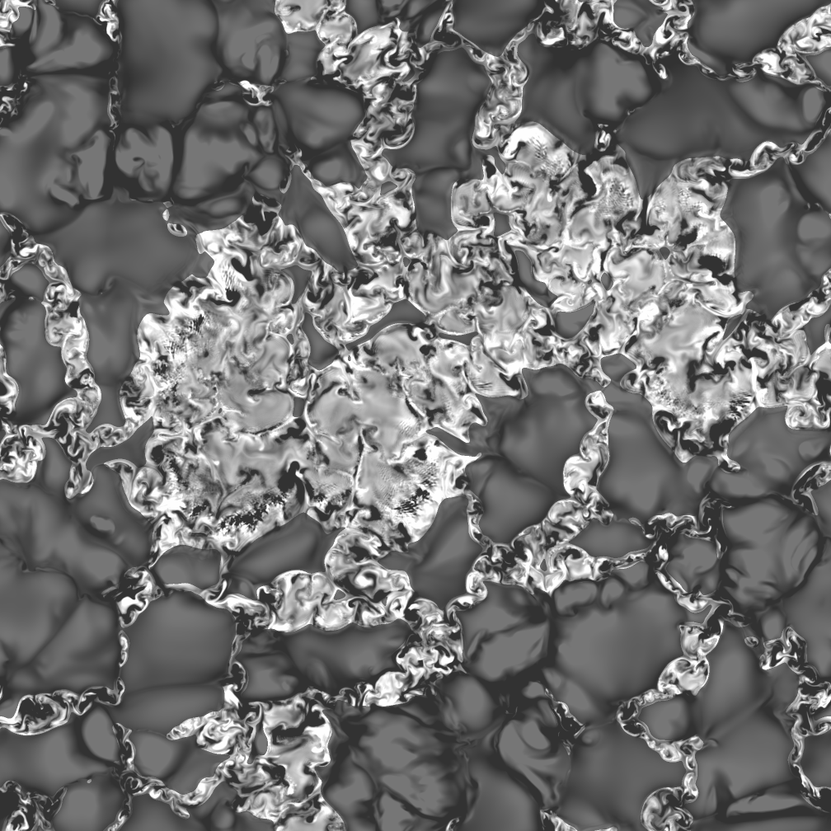
Plage region magnetoconvection
(PhD project: Anders Lagerfjärd, NBI/Cph)
12²x20 Mm simulation box
  Up to 2016²x500 grid size
  Non-zero mean vertical magnetic flux
Initial condition
  Initially uniform magnetic field evolved for several solar h
  Field strength then slowly increased until <B> ~ 600 G
  Ensures realistic initial structure
Synthetic diagnostics
  LILIA / NICOLE, 3-D synthesis version
  Compared with SST/CRISP observations of small scale plage magnetoconvection by
  Narayan & Scharmer (astro-ph 2010)
Line-of-sight velocity
Narayan & Scharmer (astro-ph 2010)
2016² x 500 simulation

Slide 12
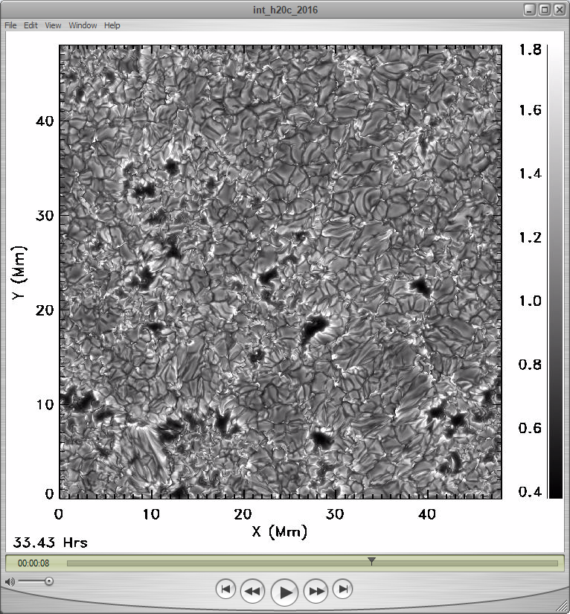
Strong Field Emergence, Spot Formation
(simulations at NASA/Ames by Bob Stein)
48² x 10 Mm AR model
  Grid size 2016² x 500 (running
  on 2016 Pleiades cores at NASA/Ames)
Initial conditions, flux emergence
  Initially 20 Mm deep box, with injection of 20 kG horizontal field at the lower boundary
  For technical reasons cut down to 10 Mm before the magnetic flux reaches the surface
  Gradual increase of surface field strength to <B²>^{1/2} ~ 1.5 G

Slide 13
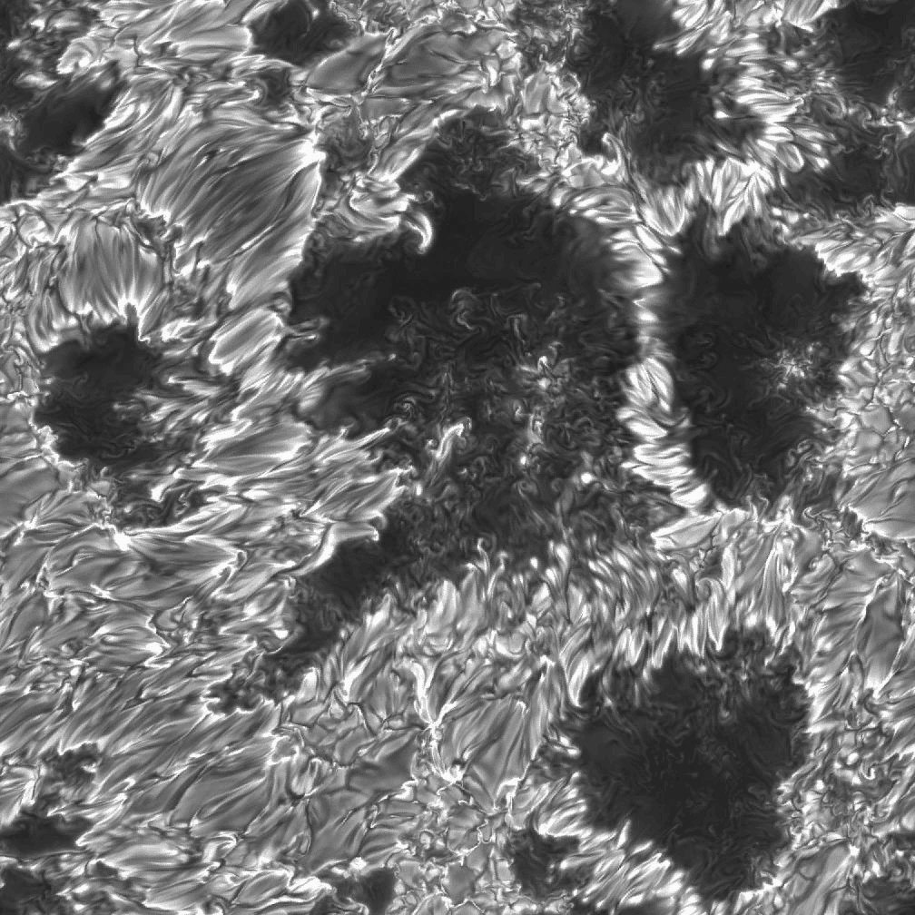
Continued spot evolution
(simulations at NASA/Ames by Bob Stein)
Size: 48² x10 Mm
Mesh: 2016² x 500

Slide 14
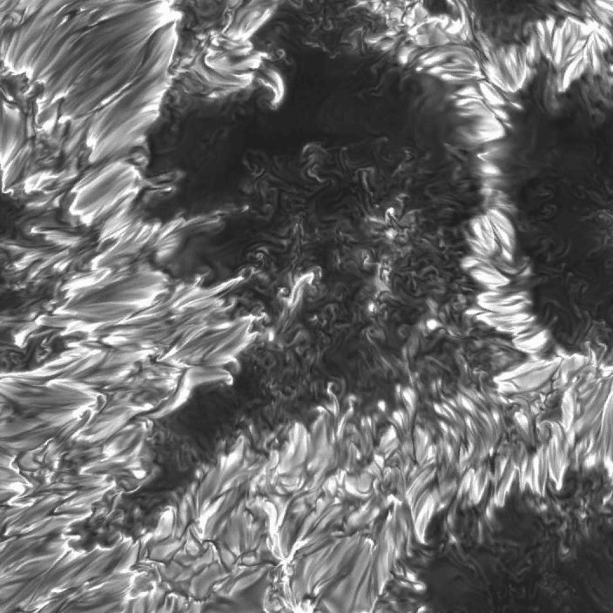
Continued Spot Evolution
Zoom in on the central spot

Slide 15
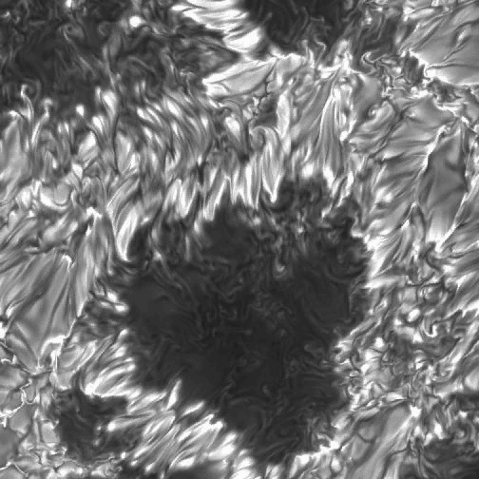
Continued Spot Evolution
Zoom in on the spot at lower right

Slide 16
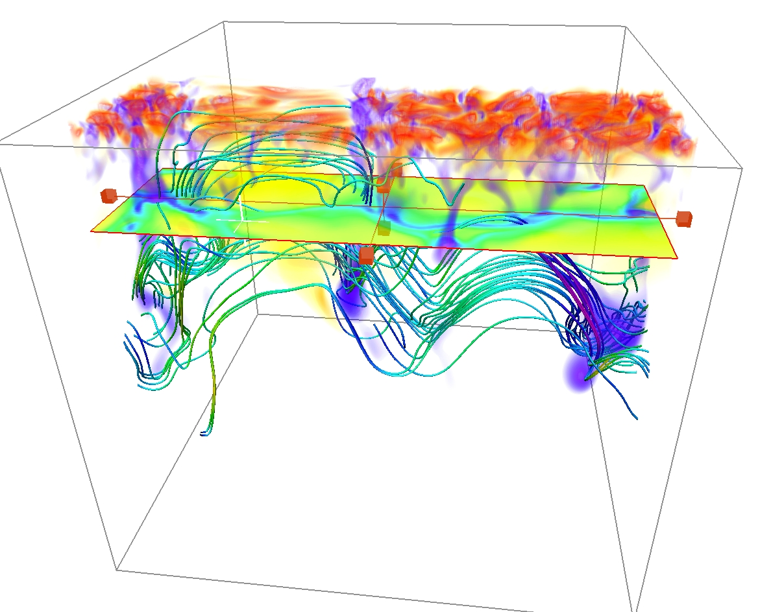
What is going on here, in all three cases?
Why do these structures form?
Convection is in general a destructive agent, with respect to ascending flux tubes
  Obvious from first principles
  Verified in a number of investigations with ’planted’ flux tubes trying to survive
But: Convection can also generate structure!
  It does so by stretching B along paths with upflows in the middle and downflows in the ”legs”

Slide 17
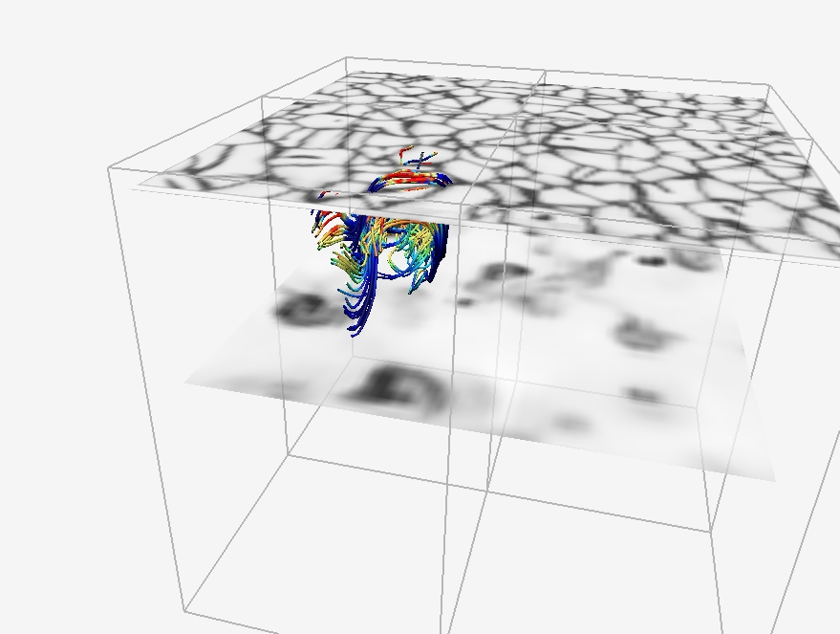
3-D (NCAR/Vapor) visualizations, illustrating the process

Slide 18
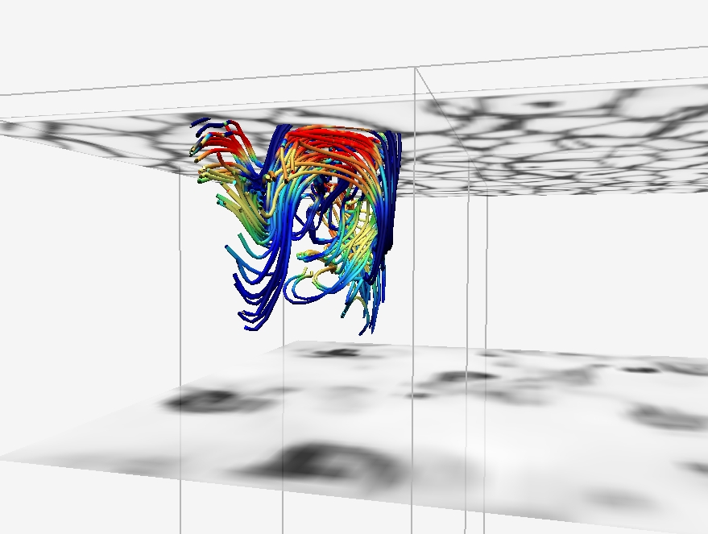

Slide 19
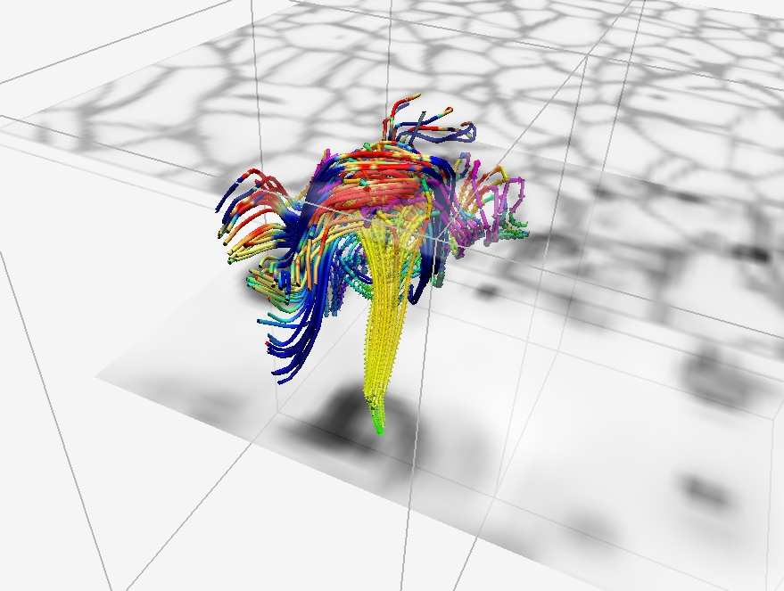

Slide 20
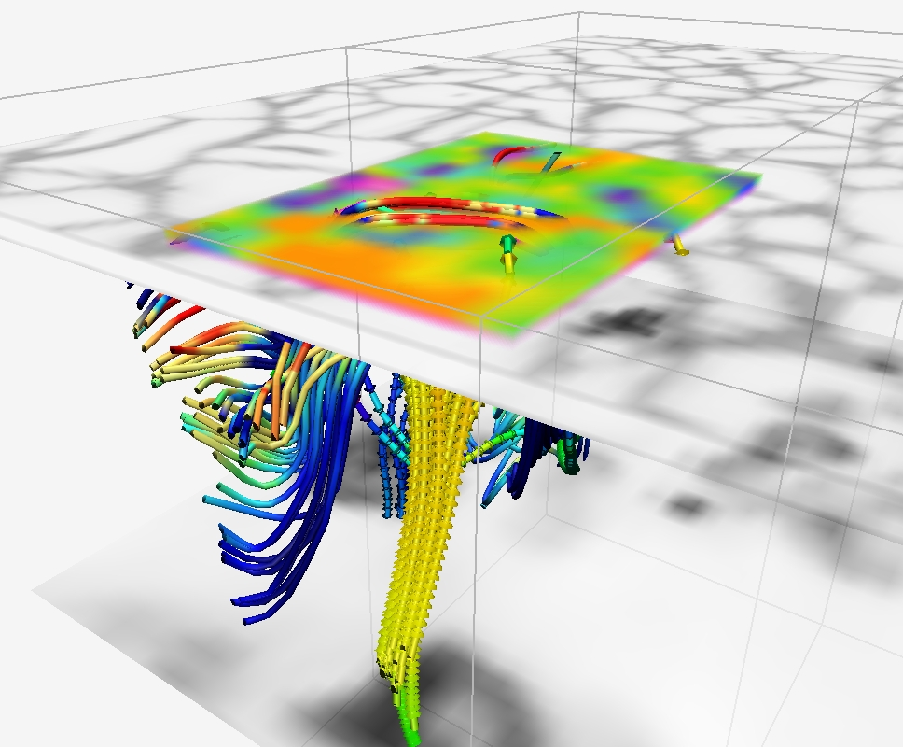

Slide 21
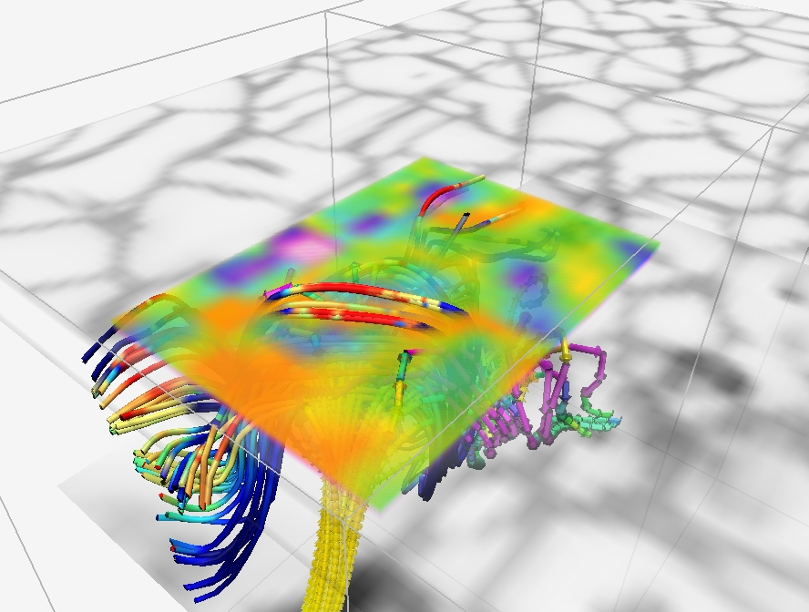

Slide 22
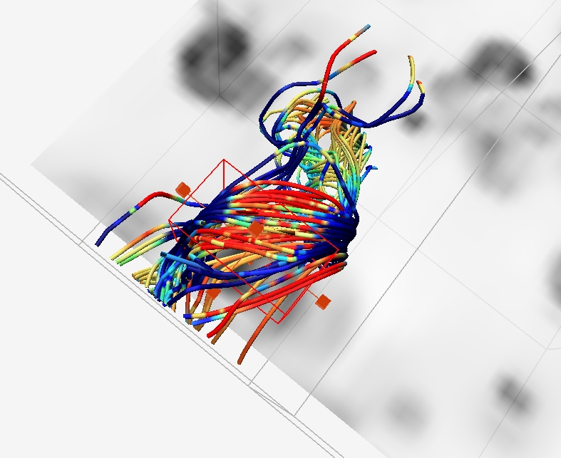
view from above

Slide 23
Solar Magnetoconvection & Sunspots;
Conclusions – methodwise
Computer capacity has now reached a level where we can begin to model solar active regions ab initio, without imposing any shapes or structures through initial or boundary conditions
Comparison between models and observations is in that situations best done with forward modeling
Line-of-sight velocity
Narayan & Scharmer (astro-ph 2010)
2016² x 500 simulation

Slide 24
Solar Magnetoconvection & Sunspots;
Main Conclusion
Emerging solar magnetic field structures, including sunspots, are not only influenced by turbulent convection, they are created and shaped by the convective motion scale hierarchy

