Slide 1
Emerging Flux Simulations
& semi-Sunspots
Bob Stein
Lagerfjärd
Å. Nordlund
D. Georgobiani

Slide 2
Objectives
Complement Flux Emergence Simulations of coherent, twisted flux tubes by using minimally structured field -> horizontal, uniform, untwisted in inflows at bottom
Investigate formation and structure of sunspots
Provide synthetic data for validating local helioseismology and vector magnetograph inversion procedures
Investigate nature of supergranulation

Slide 3
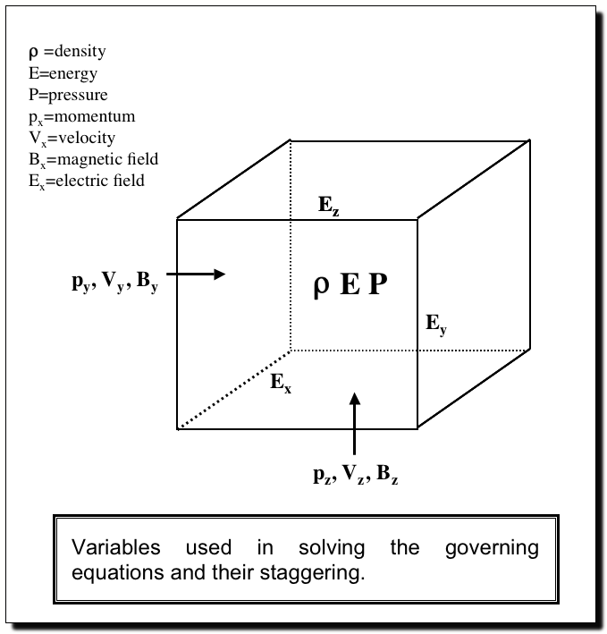
Numerical Method
Spatial differencing
  6th-order finite difference
  staggered (5th order interpolation)
Time advancement
  3rd order, low memory Runga-Kutta
Equation of state
  tabular
  including ionization, excitation
  H, He + abundant elements
Radiative transfer
  3D, LTE
  4 bin multi-group opacity

Slide 4
Simulation set up
Vertical boundary conditions: Extrapolate lnρ; Velocity -> constant @ top, zero derivative @ bottom; energy/mass -> average value @ top, extrapolate @ bottom;
B tends to potential field @ top,
Horizontal B_{x0} advected into domain by inflows @bottom (20 Mm), 2 cases: B_{x0} = 5 & 20kG
f-plane rotation, latitude 30 deg
Initial state – non-magnetic convection.

Slide 5
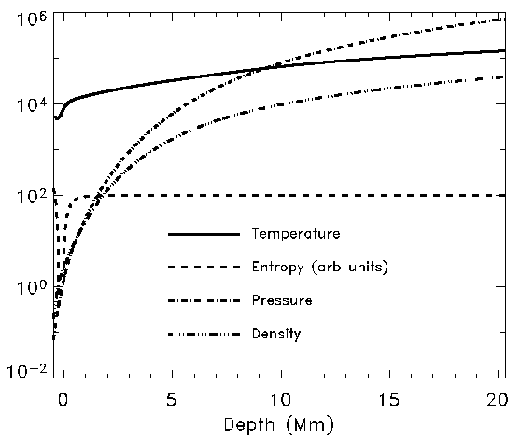
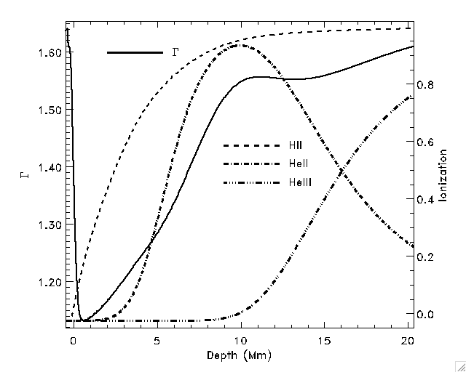
Mean Atmosphere

Slide 6
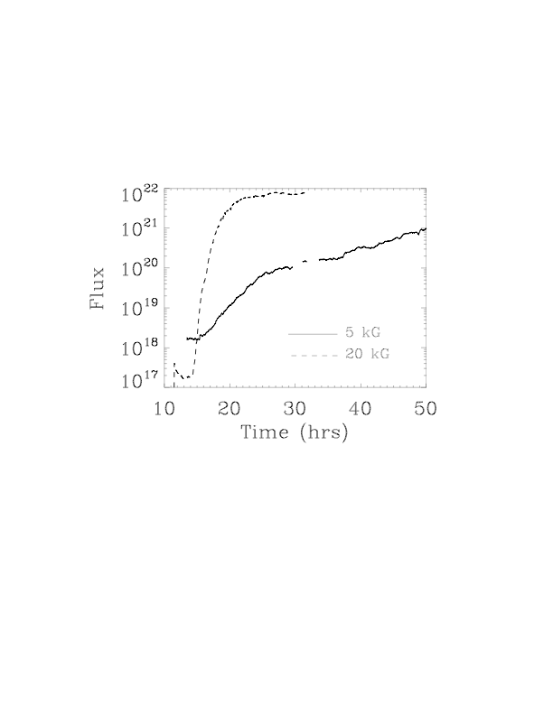
Total Unsigned Vertical Flux (48x48 Mm) at τ_{cont} = 1

Slide 7
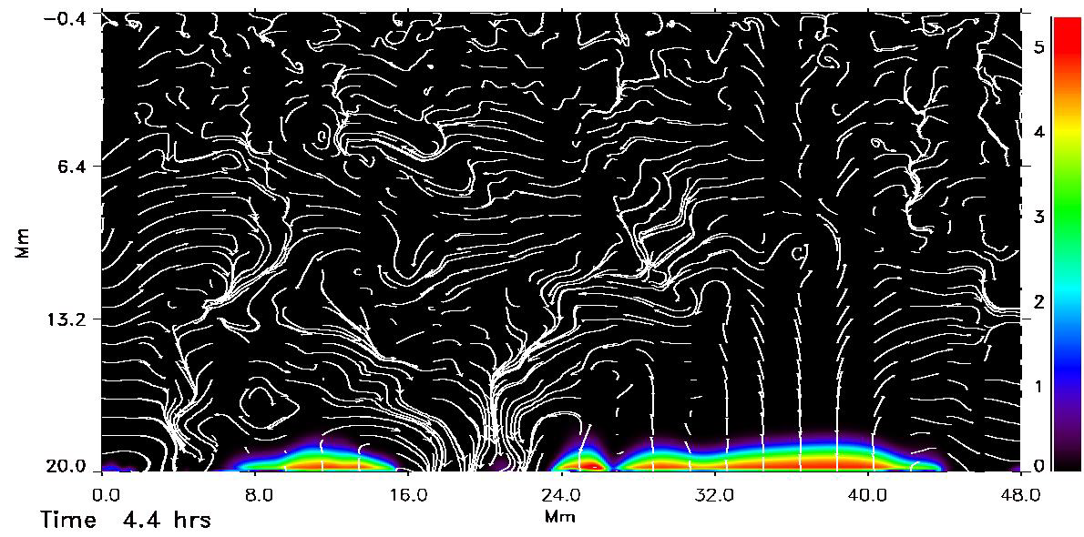
ΙBΙ & Velocity

Slide 8
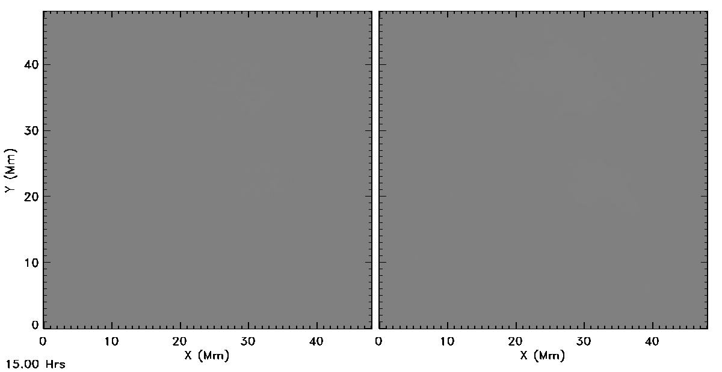
Flux Emergence
20 kG case, 15 – 32 hrs
Average fluid rise time = 32 hrs (interval between frames =1 min)
96 km horizontal resolution -> 48 km
B_{v}
B_{h}

Slide 9
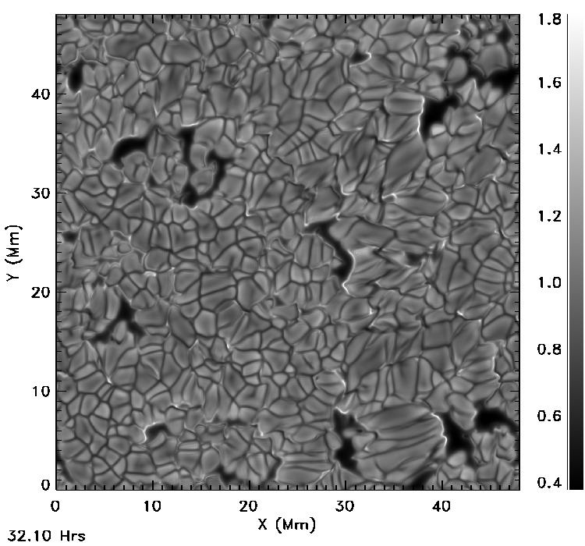
Emergent
Intensity,
I/<I>
Flux
Emergence
(20 kG case)
32.1-34.2 hrs
(interval between
frames =1 min)
Horizontal resolution
24 km.

Slide 10
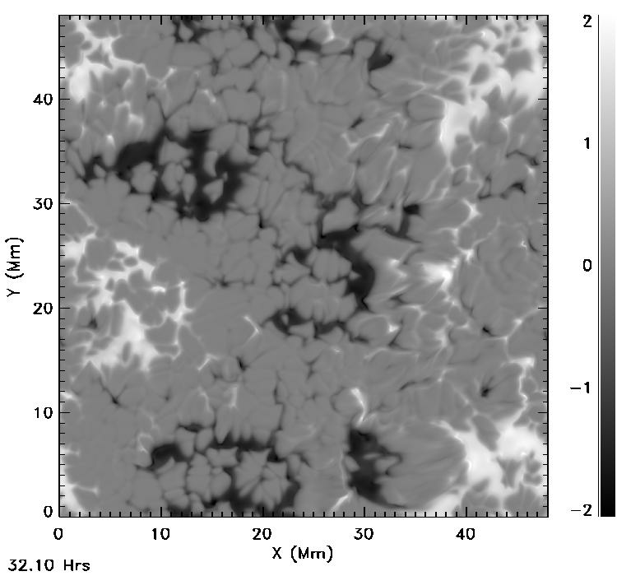
Vertical
Magnetic
Field
Pore/Spot Development
(20 kG case)
32.1-34.2 hrs
(interval between
frames =1 min)
Horizontal resolution
24 km.

Slide 11
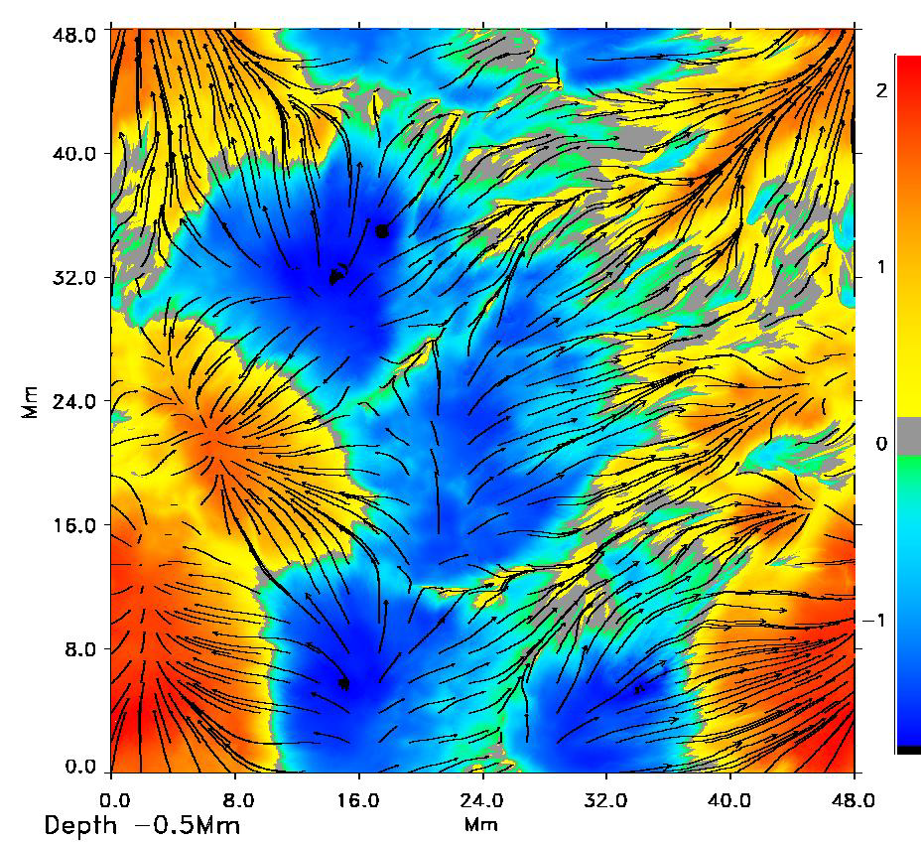
Magnetic Field (kG) scan in depth t=34.2 hrs

Slide 12
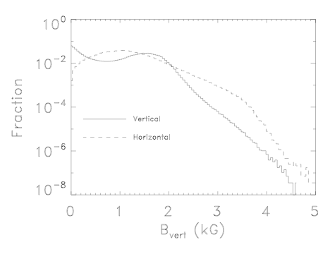
Magnetic Field Distribution @ τ = 0.1

Slide 13
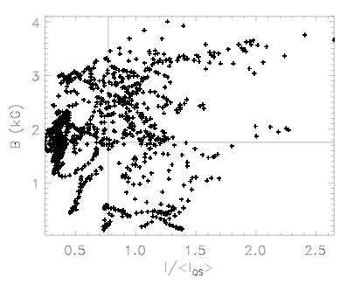
Intensity Distribution

Slide 14
Emergent Intensity

Slide 15
Vertical Velocity (blue/green up, red/yellow down) & Magnetic Field lines
(slice at 5 Mm)
weak & horizontal B
-> normal granulation
vertical B ->
velocity suppression
weak & horizontal B
-> normal granulation

Slide 16
Detail

Slide 17
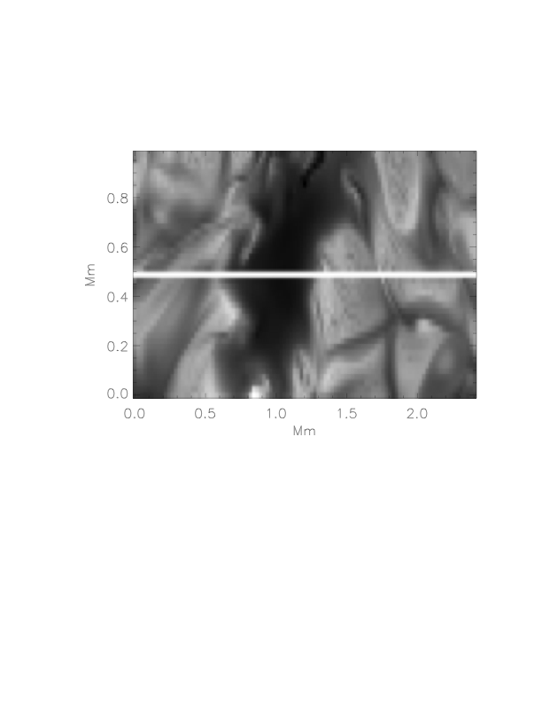
Stokes Profiles
Pore

Slide 18
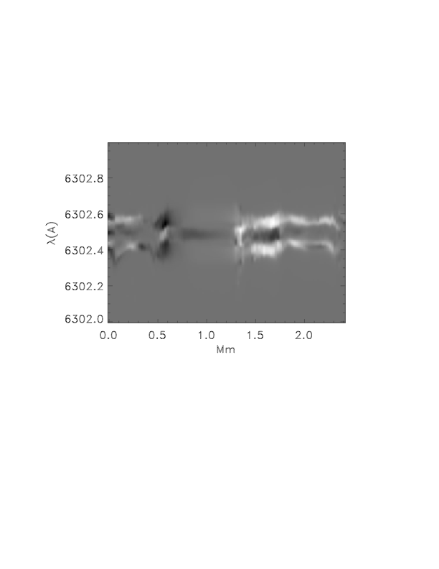
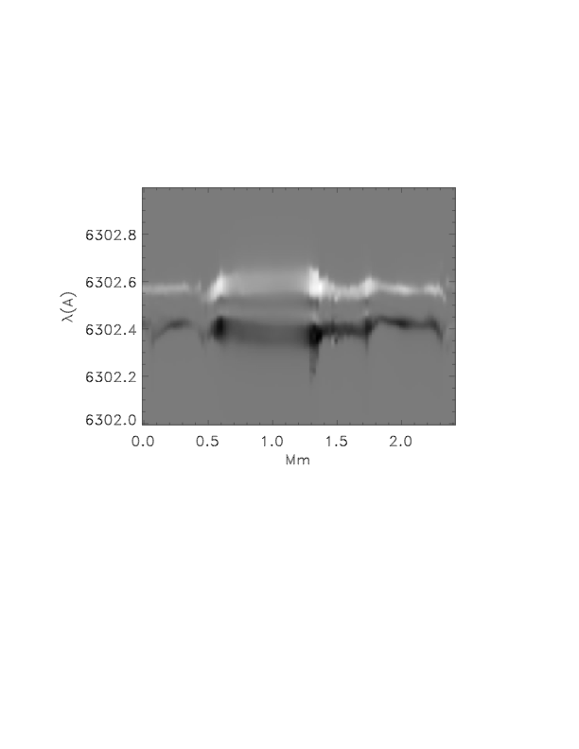
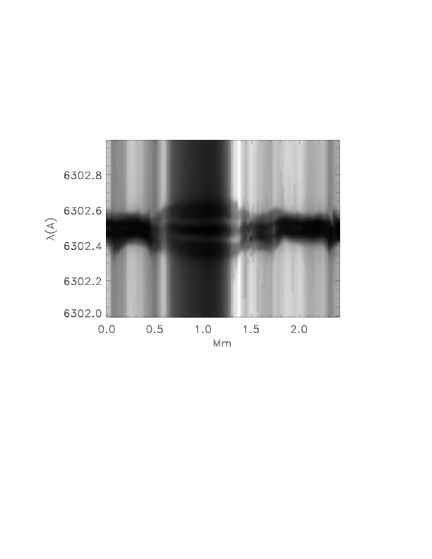
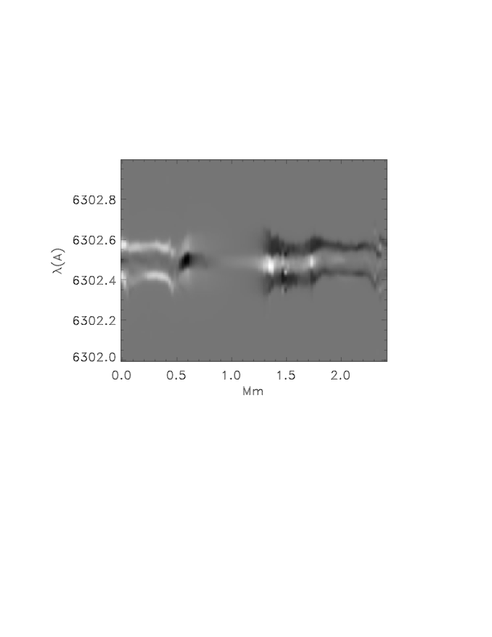
I
V
V
Q
U

Slide 19
V: simulation (left) & Hinode psf (right)
(6302.4 - 6302.6)

Slide 20
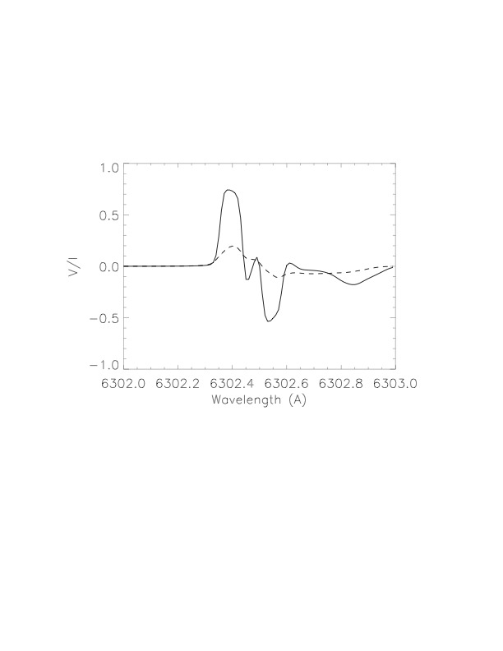
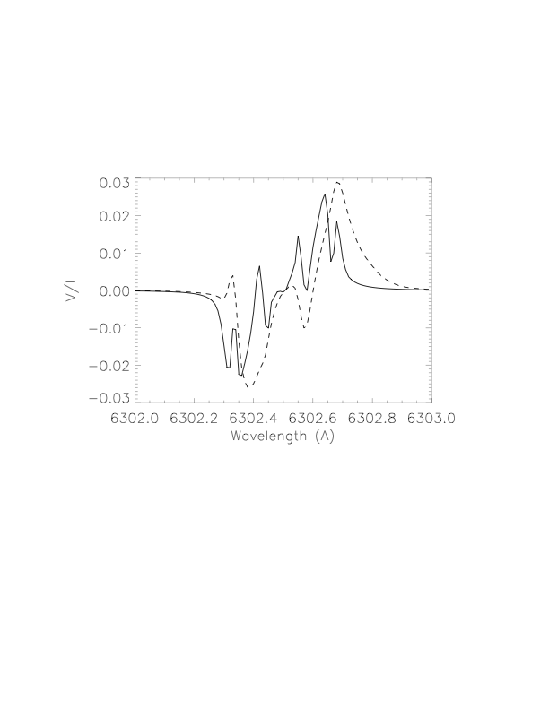
V line profiles from LILIA solid=raw, dashed = + psf

Slide 21
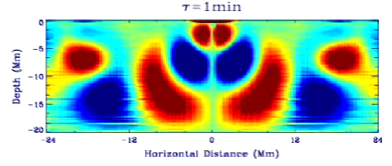
Waves in Hydro Convection

Slide 22
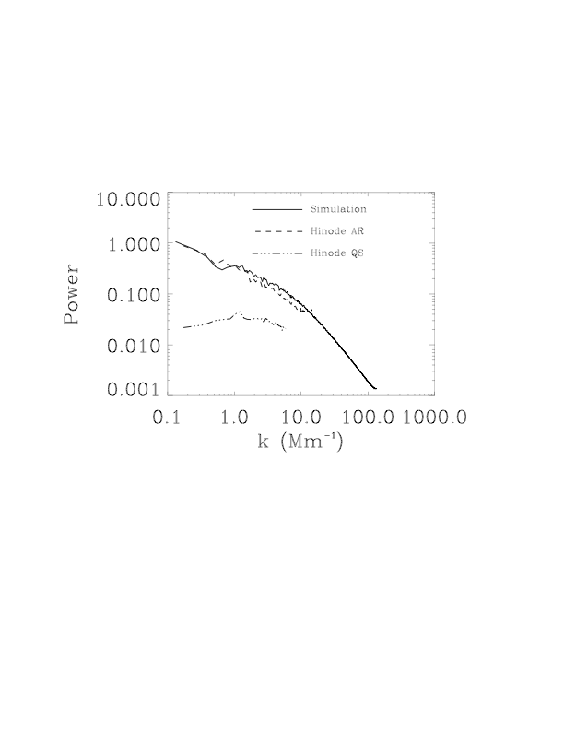
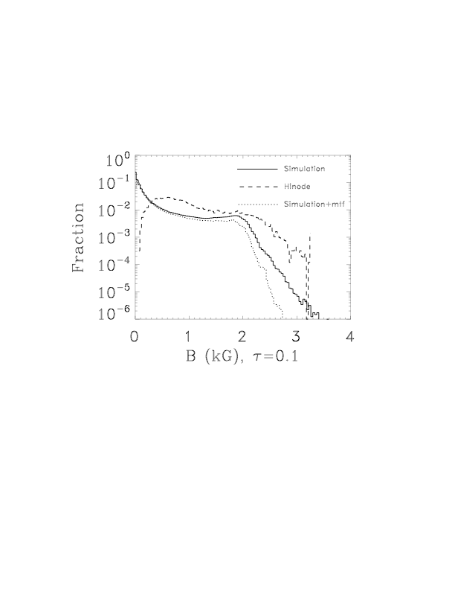
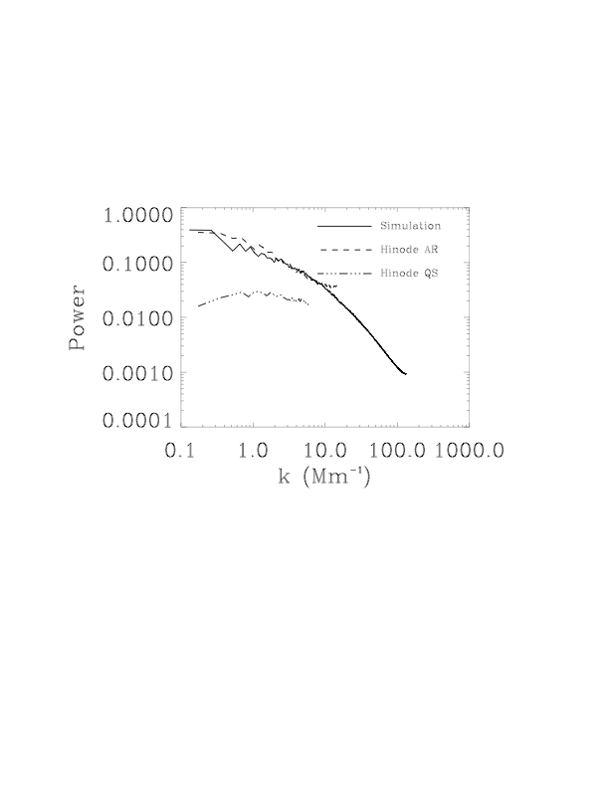
Magnetic Field
Vertical
Horizontal
Active Region

Slide 23
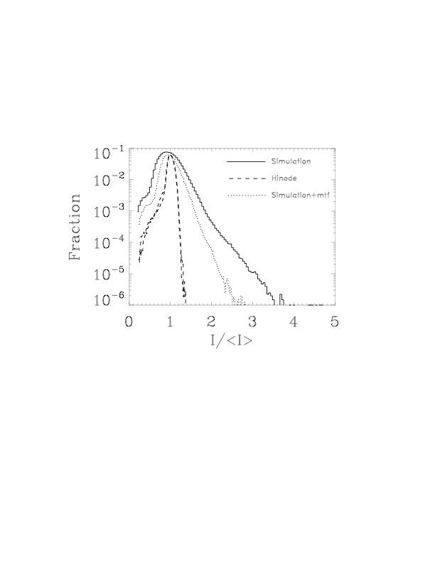
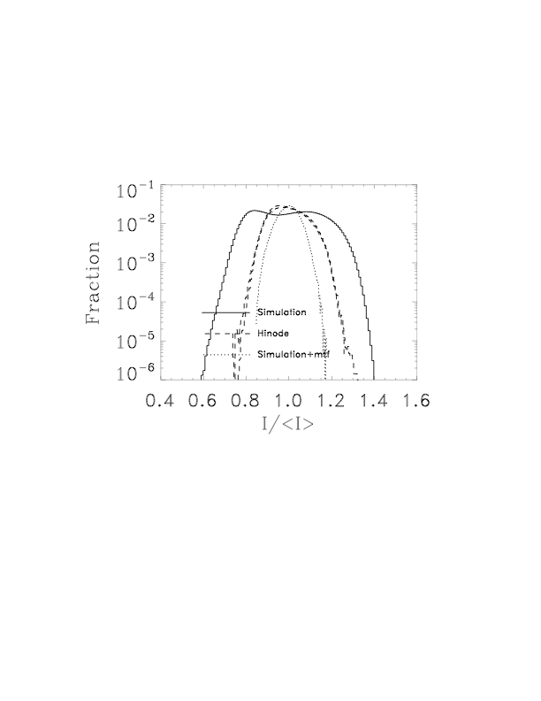
Intensity Distribution
Active Region
Quiet Sun

Slide 24
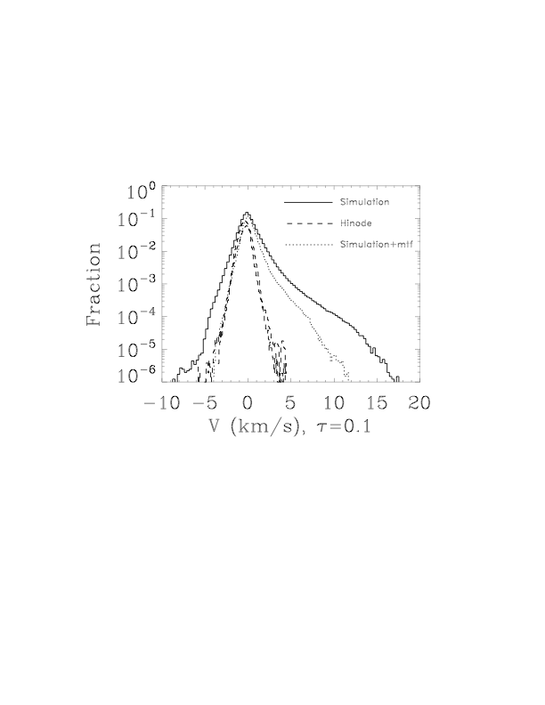
Velocity Distribution
Active Region

Slide 25
Questions:
Currently rising magnetic flux is given the same entropy as the non-magnetic plasma, so it is buoyant. What entropy does the rising magnetic flux have in the Sun? Need to compare simulations with observations for clues.
What will the long term magnetic field configuration look like? Will it form a magnetic network? Need to run for several turnover times (2 days).
What is the typical strength of the magnetic field at 20 Mm depth? Again, need to compare long runs with observations for clues.
Do we need to go to larger horizontal dimensions?

Slide 26
Location of Data
Slices at 1min. intervals of: Velocity & Magnetic Field, at τ_{cont} = 1, 0.1, 0.01. + Emergent Intensity,
@ http://steinr.pa.msu.edu/~bob
4 hour averages at 2 hour cadence of:
sound speed, temperature, density, velocity (3 directions), magnetic field (3 components)
@ steinr.pa.msu.edu/~bob/mhd48-20/AVERS4hr
Raw data cubes, averages & slices: all at
http://jsoc.stanford.edu/ajax/lookdata.html
(Hydro 48 Mm & 96 Mm, MHD eventually)

