Slide 1
Helioseismic data from
Emerging Flux
& proto Active Region
Simulations
Bob Stein – Michigan State U.
Lagerfjärd – Copenhagen U.
Å. Nordlund – Niels Bohr Inst.
D. Georgobiani – Michigan State U.

Slide 2
http://steinr.pa.msu.edu/~bob/data.html
Data
Notes:
next slide has image of the page.
This page contains links to all the data

Slide 3
Notes:
The computational domain is 48 Mm wide and extends from the temperature minimum 0.5 Mm above <tau>=1 down to 20 Mm below. Spatial derivatives are calculated by 6th order finite differences. Time advance is by 3rd order Runge-Kutta.
Variables are staggered in space, with scalars density and energy at cell centers, vectors momenta and magnetic field at cell faces.
Horizontal boundaries are periodic. The top and bottom boundaries specified by loading ghost zones and are open to fluid motions. All variables, except for the magnetic field, are extrapolated in outflows.
At the top the log of the density is extrapolated everywhere, the energy per unit mass is forced to a constant value and the velocities are constant in the ghost layers at their boundary value. At the bottom the velocity tends toward vertical, and the density and energy are specified in inflows to keep the entropy of incoming material constant.
The magnetic field is made to tend toward a potential field at the top and at the bottom its value is specified in inflows and extrapolated in outflows.

Slide 4
Main trunk: B_{bottom} increasing 200G -> 10 kG, e-folding time 5 hours (mhd48-0)
Branch: B_{bottom} reached 1 kG at 11.5 hours, kept constant thereafter (mhd48-1)
Branch: B_{bottom} reached 5 kG at 19.6 hours, kept constant thereafter (mhd48-5)
Branch: B_{bottom} reached 10 kG at 23 hours, kept constant thereafter (mhd48-10)
Links to each data set
Notes:
The simulation was started from a snapshot of hydrodynamic convection that had relaxed both thermally and dynamically. Uniform, untwisted, horizontal field at an angle of 30º to the x-axis was advected by inflows into the computational domain from the bottom. The field strength everywhere was slowly increased (with e-folding time of 5 hours). When the magnitude of the horizontal field in the inflows at the bottom reached 1, 5 and 10 kG, branches were started with the boundary field kept constant at those values and the interior evolved freely. Two branches are being actively followed – 1 and 5 kG. The 5 kG run has spontaneously formed a pore. The pore formed at 19.98 hours and has been growing is size since (now 6 hours later). The 1 kG case has not formed any pores yet.

Slide 7
The Simulation
48 Mm wide x 20 Mm deep
12-80 km vertical & 24 km horizontal resolution
Advect minimally structured magnetic field -- horizontal, uniform, untwisted – by inflows at bottom
Gradually increase field strength to desired level with 5 hour e-folding time
Objectives:
  Investigate flux emergence, formation of pores & sunspots (without
  ad hoc boundary conditions)
  Provide synthetic data for validating local helioseismology &vector magnetograph inversion procedures
  Determine nature & origin of supergranulation

Slide 8
Pore Formation
Once B_{bottom} reached 5 kG stopped increasing field strength.
Magnetic flux from the edge of a large loop separated and formed a vertical flux concentration “flux tube” near the surface.
The “flux tube” grows in strength as more magnetic field lines are swept into it and a pore forms.
A time sequence is shown in the following slides
Notes:
The intensity in the pore varies between 20% and 40% of the average intensity. There are bright structures with 2-3 times the average intensity.

Slide 9
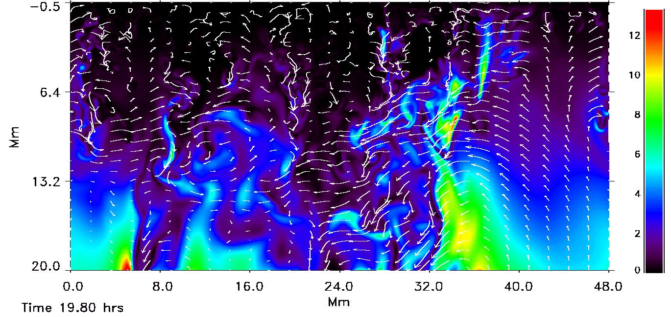
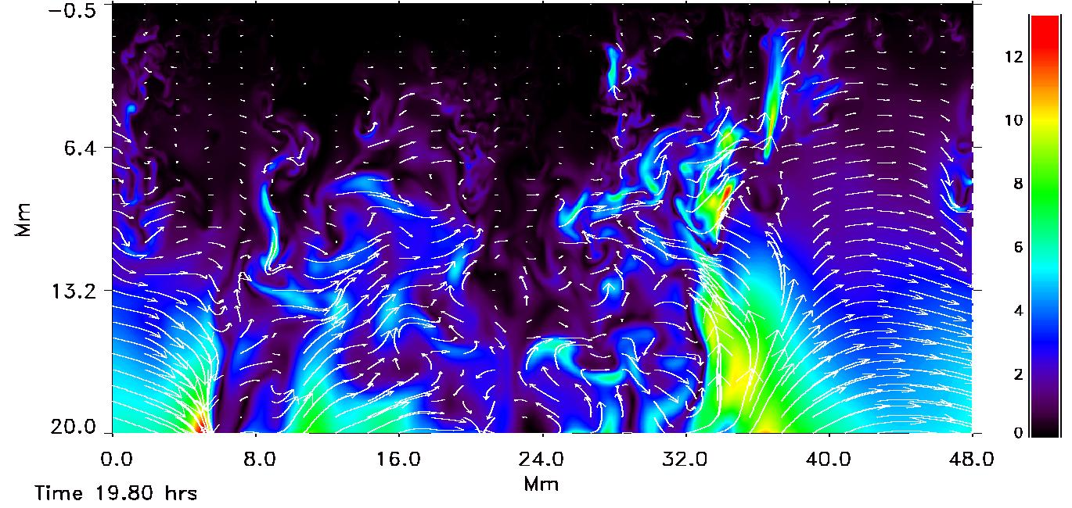
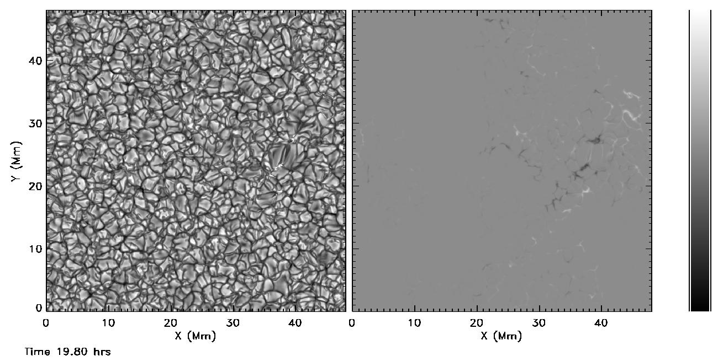
|B| & V_{hv}
scale |B|: kG
|B| & B_{hv}
Emergent Continuum Intensity
&
Vertical B (τ=0.1)
scale I: [ 0.2,3] <I_{QS}>
scale B_{v}: [-4,3] kG
Notes:
Upflows carry large loop toward surface, while downflows pin down magnetic flux and prevent it from rising (top panel of |B| and velocity vectors)
Flux begins to emerge in pepper and salt pattern of mixed polarities and granules have become distorted and elongated in direction of field (bottom panel)
Vertical flux concentration has formed hear the surface at the edge of a large loop (middle panel of |B| and B vectors)
Gray scale for intensity is in units of Quiet Sun average intensity, range from darkest to lightest is [0.2,3]<IQS>, but ends have been clipped
Gray scale for magnetic field is in units of kG with range [-4,3] kG

Slide 10
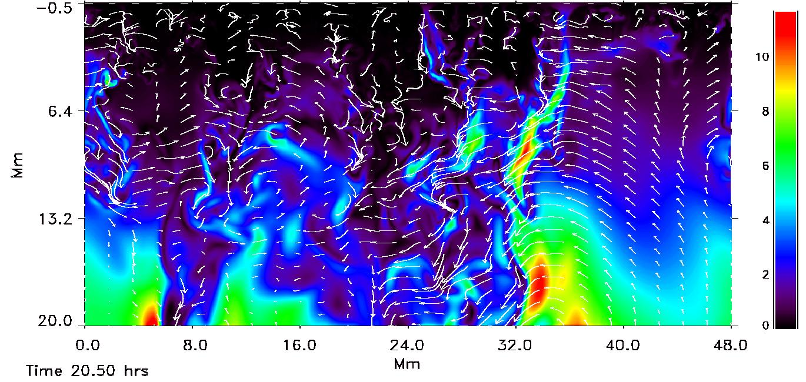
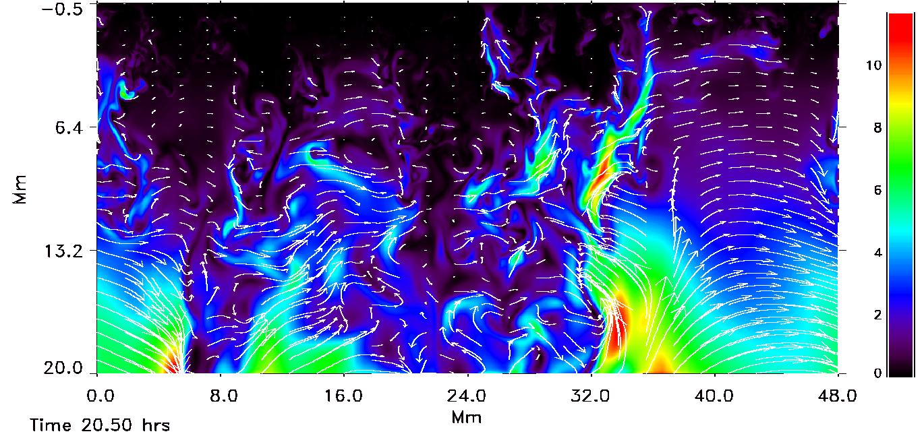
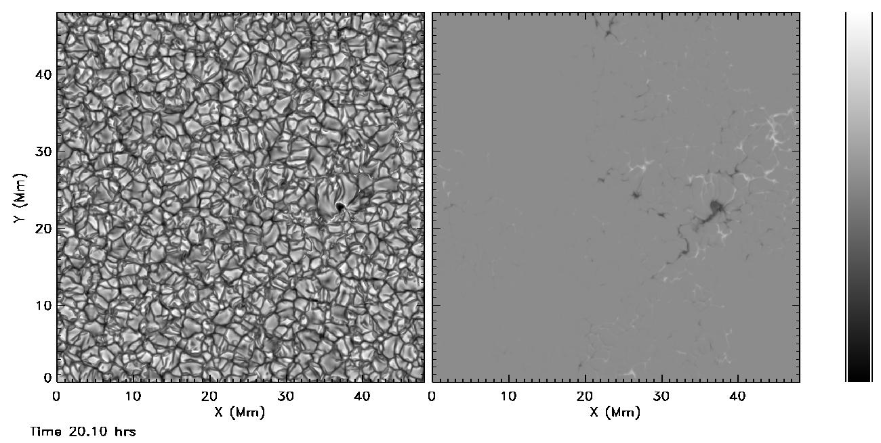
|B| & V_{hv}
scale |B|: kG
|B| & B_{hv}
Emergent Continuum Intensity
&
Vertical B (τ=0.1)
scale I: [ 0.2,3] <I_{QS}>
scale B_{v}: [-4,3] kG
Notes:
Pore formed first at 19.98 hours.

Slide 11
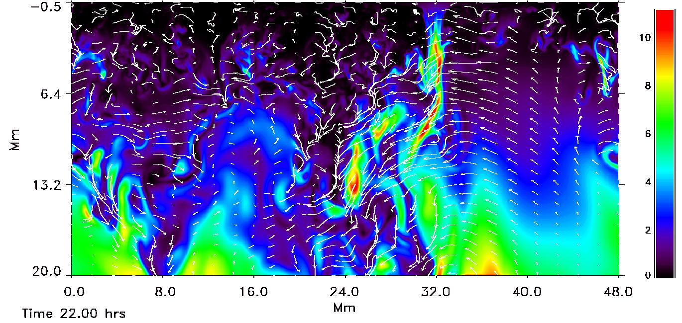
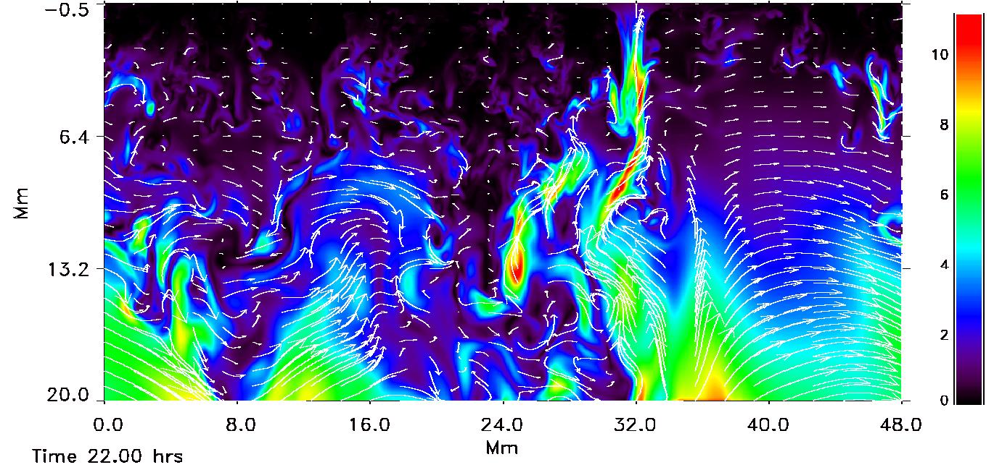
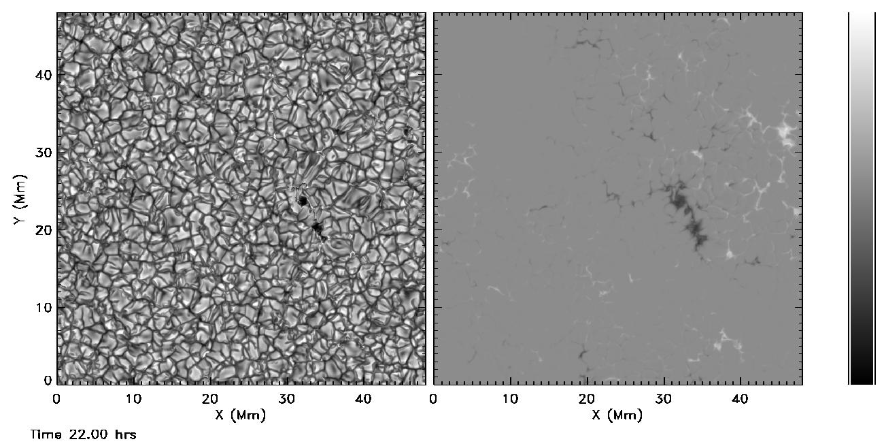
|B| & V_{hv}
scale |B|: kG
|B| & B_{hv}
Emergent Continuum Intensity
&
Vertical B (τ=0.1)
scale I: [ 0.2,3] <I_{QS}>
scale B_{v}: [-4,3] kG
Notes:
Two small pores exist. Both have same polarity.
Magnetic field has separated in to regions of opposite polarity.

Slide 12
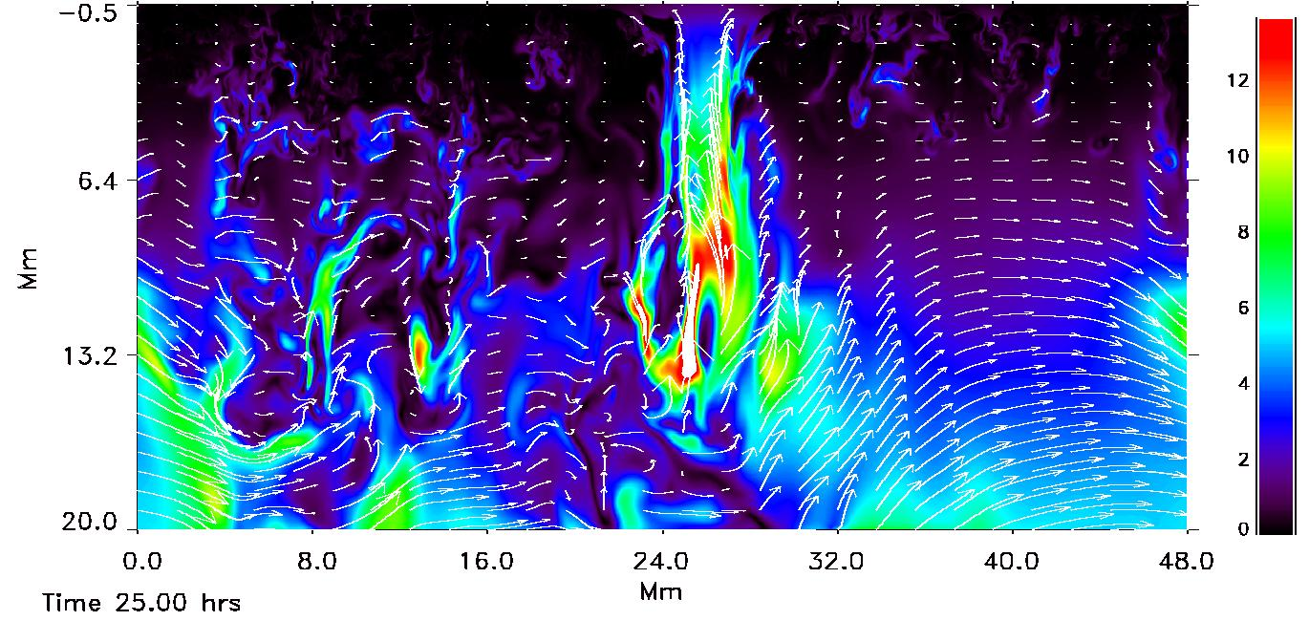
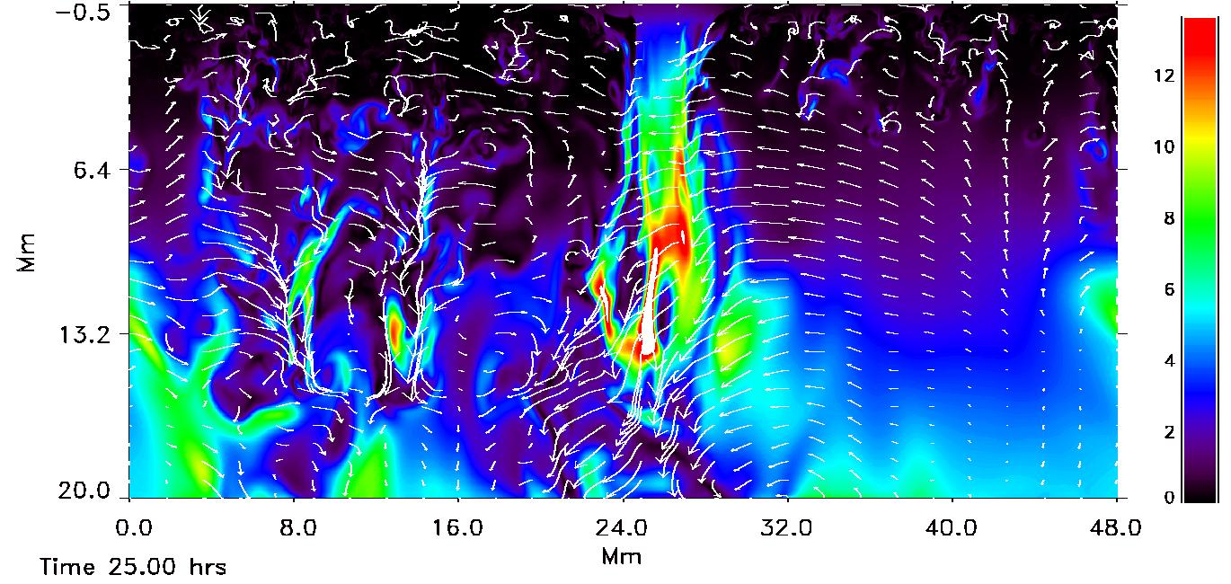
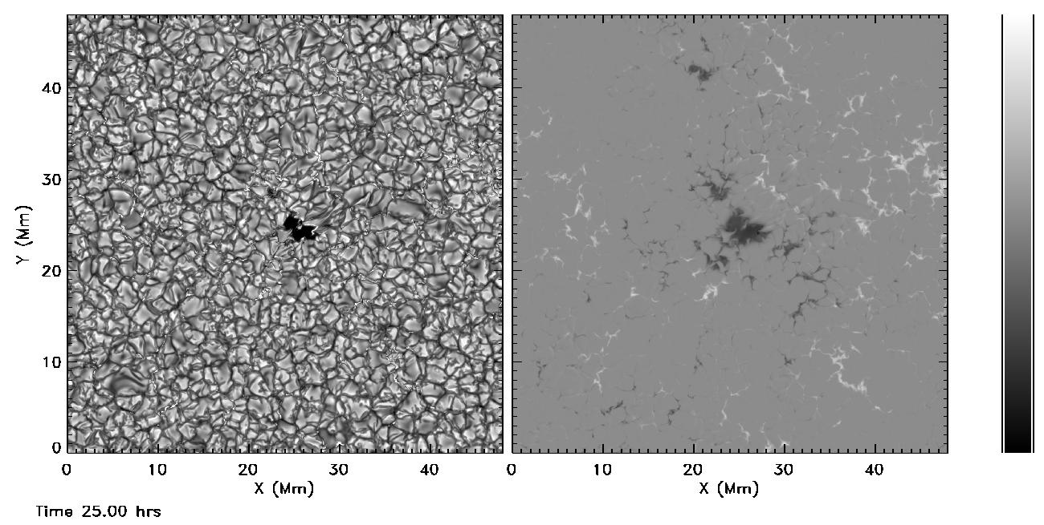
|B| & V_{hv}
scale |B|: kG
|B| & B_{hv}
Emergent Continuum Intensity
&
Vertical B (τ=0.1)
scale I: [ 0.2,3] <I_{QS}>
scale B_{v}: [-4,3] kG
Notes:
One pore has grown
Pore is moving to left due to large scale horizontal flows in its vicinity.
Pore magnetic structure is extending deeper.

Slide 13
Notes:
Magnetic “flux tube” extends deep into the computational domain, but not all the way to the bottom. Field lines in the “flux tube” connect to a wide variety of locations, including the purple one which is a U-loop. The blues and green seem to come from the edge of a mid-sized loop in the deeper layers as is also indicated in the vertical slices. A time sequence (from which this is a snapshot) shows that field lines are moving into the “flux tube” from its surroundings.

Slide 14
Active Region Model
Another simulation
20 kG field advected into domain at bottom
Several pores form
Then B artificially increased α B. Pores increase in area with only slight increase in B, since in pressure equilibrium with surroundings, B only increases as Wilson depression deepens.

Slide 15
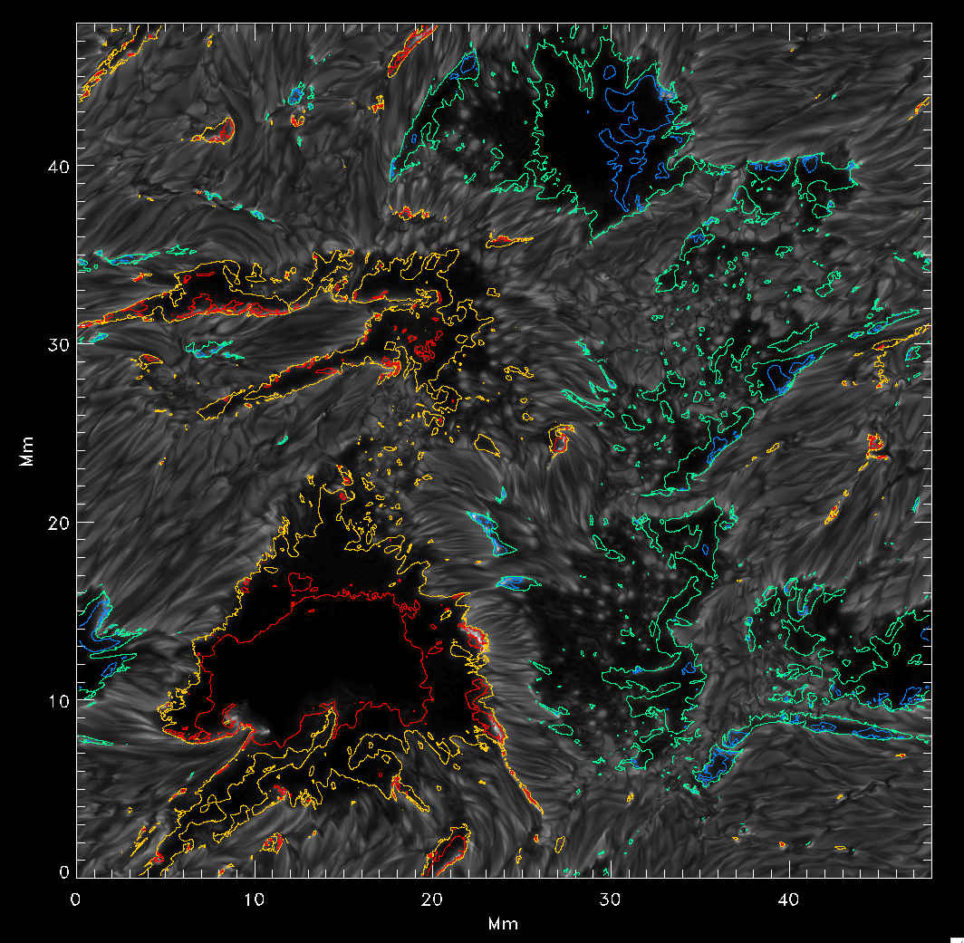
Proto-SPOTS
Intensity
+
B_{vertical}
-2.5 blue,
-2 green,
2 yellow,
2.5 red
(kG at τ=0.1)
Notes:
This is from a different simulation. 20 kG field was advected in from the bottom. Once several pores had formed, the magnetic field was increased everywhere in proportion to its magnitude. This made the pores grow in size and become darker. The flux concentrations are very close together. There are some penumbral like structures, but it is not possible to clearly distinguish them.

Slide 16
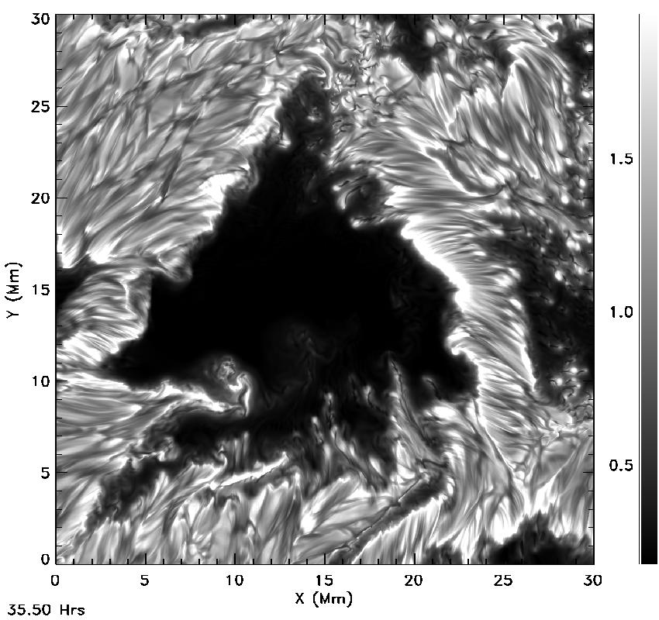
Proto-Spot 1
Flux ~1x10¹⁹ Mx
in this proto-spot
Notes:
Full resolution image of proto-spot intensity.
Note: one plume seems to go under another in lower right of proto-spot.
There is large shearing motions outside the proto-spot in the upper left region.

Slide 17
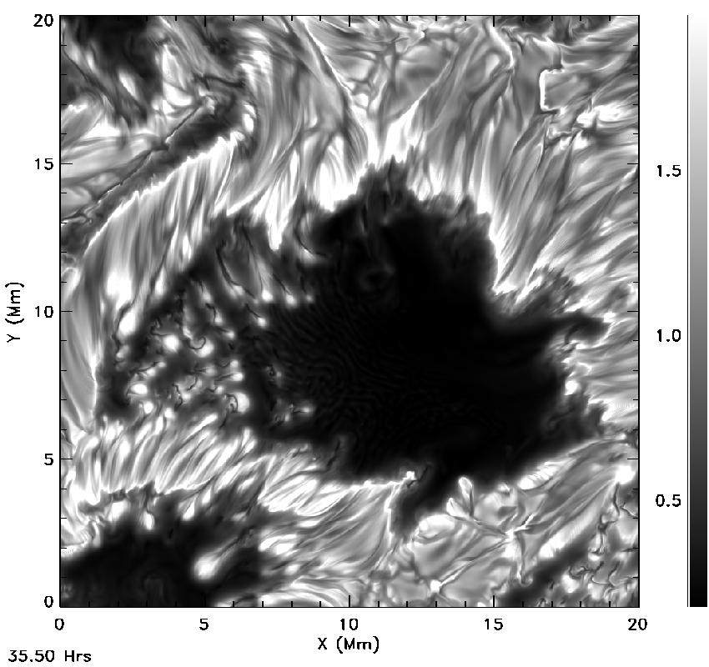
Proto Spot 2
Notes:
Another proto-spot.

Slide 18
http://steinr.pa.msu.edu/~bob/data.html
Reminder –Data is @
Notes:
next slide has image of the page.
This page contains links to all the data

