Slide 1
Emerging Flux
& proto Active Region
Simulations
Bob Stein – Michigan State U.
Lagerfjärd – Copenhagen U.
Å. Nordlund – Niels Bohr Inst.
D. Georgobiani – Michigan State U.

Slide 2
http://steinr.pa.msu.edu/~bob/data.html
Data

Slide 3
The Simulation
48 Mm wide x 20 Mm deep
12-80 km vertical & 24 km horizontal resolution
Advect minimally structured magnetic field -- horizontal, uniform, untwisted – by inflows at bottom
Gradually increase field strength to desired level with 5 hour e-folding time
Objectives:
  Investigate flux emergence, formation of pores & sunspots (without
  ad hoc boundary conditions)
  Provide synthetic data for validating local helioseismology &vector magnetograph inversion procedures
  Determine nature & origin of supergranulation

Slide 4
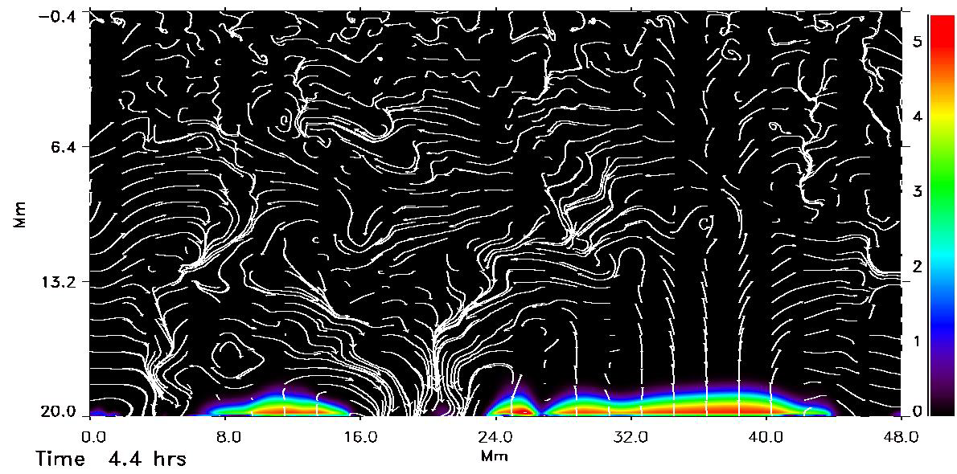
Emerging Magnetic Flux
ΙBΙ & Velocity

Slide 5
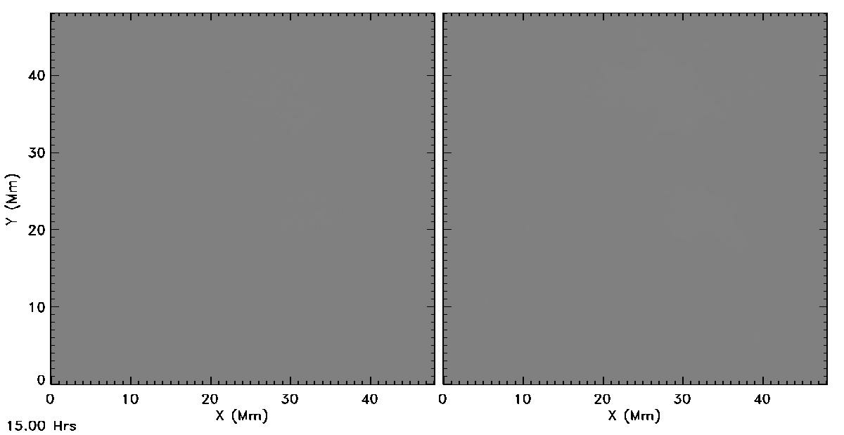
Flux Emergence
20 kG @ 20 Mm depth @ 30º to x-axis, 15 – 32 hrs
Average fluid rise time = 32 hrs (interval between frames =1 min)
96 km horizontal resolution -> 48 km
B_{v}
B_{h}

Slide 6
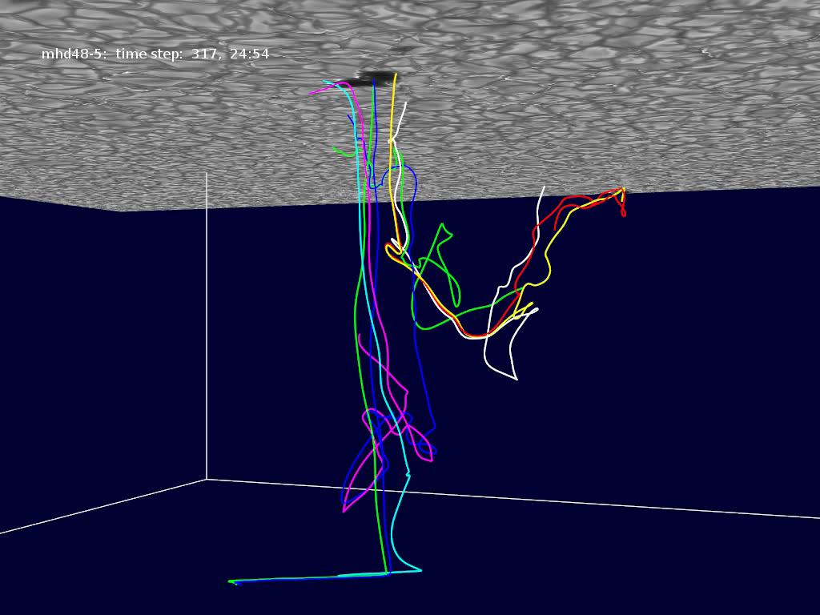

Slide 7
t=25.44 hrs
Top
B vectors
B (kG)
Bottom
V vectors
lg B (kG)

Slide 8
t=24.89 hrs
Top
B vectors
B (kG)
Bottom
V vectors
lg B (kG

Slide 9
t=23.53 hrs
Top
B vectors
B (kG)
Bottom
V vectors
lg B (kG

Slide 10
t=21.72 hrs
Top
B vectors
B (kG)
Bottom
V vectors
lg B (kG

Slide 11
t=20.78 hrs
Top
B vectors
B (kG)
Bottom
V vectors
lg B (kG

Slide 12
t=20.19 hrs
Top
B vectors
B (kG)
Bottom
V vectors
lg B (kG

Slide 13
t=19.11hrs
B vectors
B (kG)

Slide 14
t=12.64 hrs
B vectors
B (kG)

Slide 15
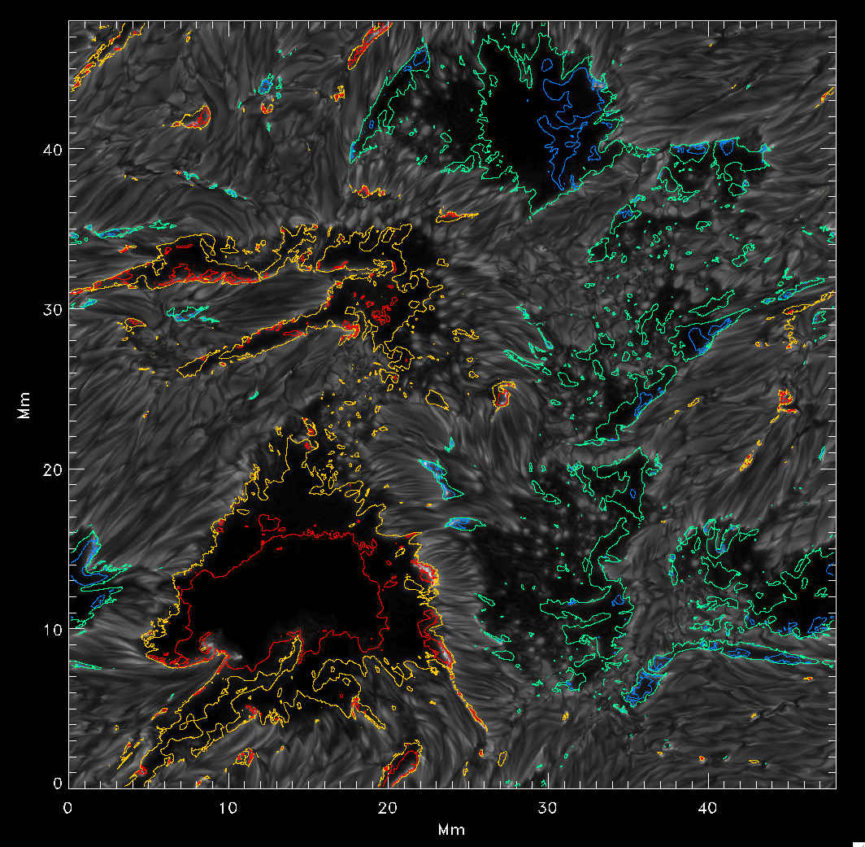
SPOTS
Intensity
+
B_{vertical}
-2.5 blue,
-2 green,
2 yellow,
2.5 red
(kG)

Slide 16
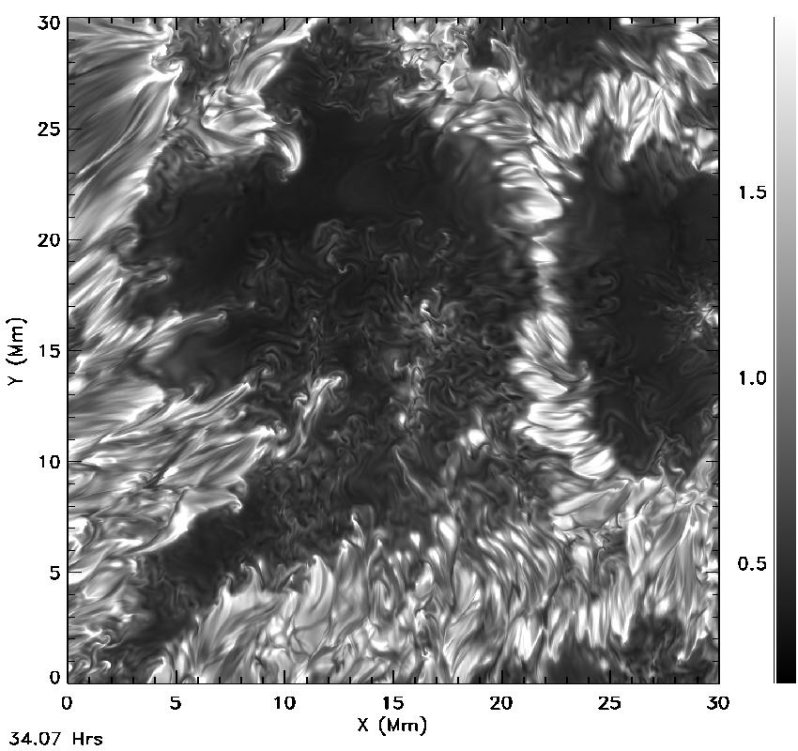
Proto-Spot 1 Evolution
Flux increase has
stopped,
~1x10¹⁹ Mx
in this spot

Slide 17
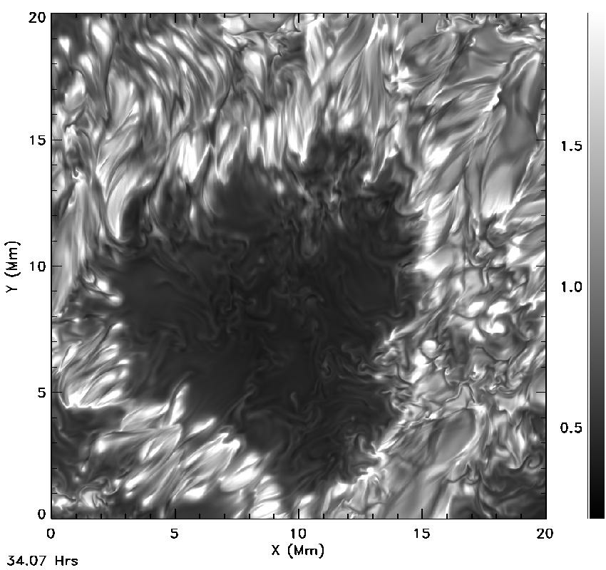
Proto Spot 2

Slide 18
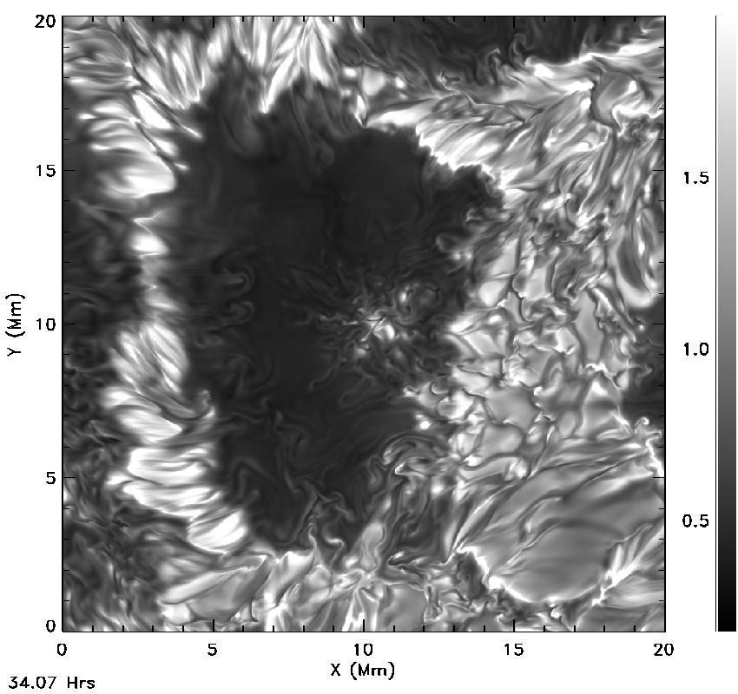
Proto Spot 3 disappearing

