Slide 1
Models of the 5-Minute
Oscillation & their Excitation
Bob Stein – Michigan State U.

Slide 2
What did we know about the solar oscillations way back then?
Broad, featureless spectrum with maximum ~ 300 s.
Period of maximum decreases with increasing height in the atmosphere
Oscillations are standing waves:
  Intensity leads velocity by ~ 90º
  Waves are in phase over range of heights

Slide 3
Oscillation spectrum
(Orrall 1966)

Slide 4
V-I phase
Fe 5576
Lites & Chipman 1979
At low frequency: in phase = intensity of granules;
At high frequency: in phase = propagating acoustic waves;
At 5 min (ω~0.02):
I leads V by ~ 90º

Slide 5
The Models
Ringing of Atmosphere at Cutoff Frequency
Resonant Eigenmodes

Slide 6
Cutoff Frequency Singularity
For vertical, isothermal waves driven by pressure fluctuations (due to granules) the solution for the displacement is (Noyes 63)
Where the wave vector is
So waves near the cutoff frequency,υ_{c} ~ 300 s,
will be preferentially ampified.
Also: Kato 1966, Souffrin 1966, 1970, Moore 1974
Notes:
Physical reason: pressure fluctuation -> density fluctuation ~ dxi/dz = k*xi -> at cutoff frequency, so compression is very small unless amplitude is very large.
Further, waves with frequency below the cutoff frequency will by attenuated with height, so the period of observed waves will decrease with height.
Problem: observed oscillation frequency in photosphere is lower than the cutoff frequency

Slide 7
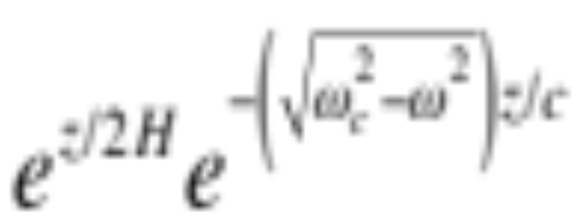
Linear Filtering
Wave
amplitude grows exponentially, but at non-propagating frequencies the amplitude is damped
Noyes, 1963; Souffrin, 1966
Notes:
Problem: observed oscillations are evanescent, not propagating, and oscillations are observed from CZ up.

Slide 8
Pulse wake
V_{group} -> 0 at υ->υ_{c}
Higher frequency waves run ahead,
Leave behind oscillating standing wake
at υ=υ_{c}
Stix 1970
Notes:
Problem: wake dies out quicker than length of observed oscillation choherence

Slide 9
Resonant Cavities
3 layer model:
T_{min} = 4300
Chromosphere=10⁴
Corona or Interior=10⁶
Acoustic waves trapped between cool photosphere and hot corona (or interior), (region IIa),
or in cool layer between 2 hot layers in T_{min} region for ω>ω_{ac} (region Ia).
Gravity waves trapped in cool layer (N_{BV} large) between 2 hot layers (N_{BV} small) (region Ig),
or between hot and cold layers (region Iig).
Only region Iia, acoustic waves trapped below photosphere or in corona match observed oscillation frequency and horizontal wave number.

Slide 10
Resonant Eigenmodes
Cavity: the chromosphere
  Bottom = cool photosphere (high cutoff frequency, steep density gradient) = rigid boundary
  Top = transition region (steep temperature, density gradient) = free boundary
  Bahng & Schwarzschild 1963
  Meyer & Schmidt 1966
  Uchida 1965, 1967
  Stein & Leibacher 1969
  McKenzie 1971

Slide 11
Structure in the Spectrum
In 1968 Frazier observed some structure in the spectrum & it was possible to quantify the cavity:
Notes:
Length=2.8 Mm, Mean temperature = 7500 K

Slide 12
For vertically propagating waves the ratio of mode frequencies is
Where the vertical wave vectors for a free upper boundary are
Thus the length of the cavity is
where H=P/ρg=RT/μg
and
where
Thus the mean temperature is
Hence, from Frazier’s observations the cavity’s length and temperature are

Slide 13
Cavity: Photosphere
Non-divergent, surface gravity waves (f-mode) ω=√gk. Boundary conditions: chromosphere-corona transition region is free surface, interior has increasing scale height H (temperture). (Jones 1969)
Trapped internal gravity waves (Uchida 1967, Ulmschneider 1968)

Slide 14
Cavity Interior: Roger Ulrich 1970
Leibacher & Stein 1971
Top Boundary: cool photosphere with low cutoff frequency
Bottom Boundary: high temperature interior refracts waves back toward surface

Slide 15
Modes: k-Ω – Roger Ulrich
Frazier 68 observations
Tanenbaum et al. 69 observations

Slide 16
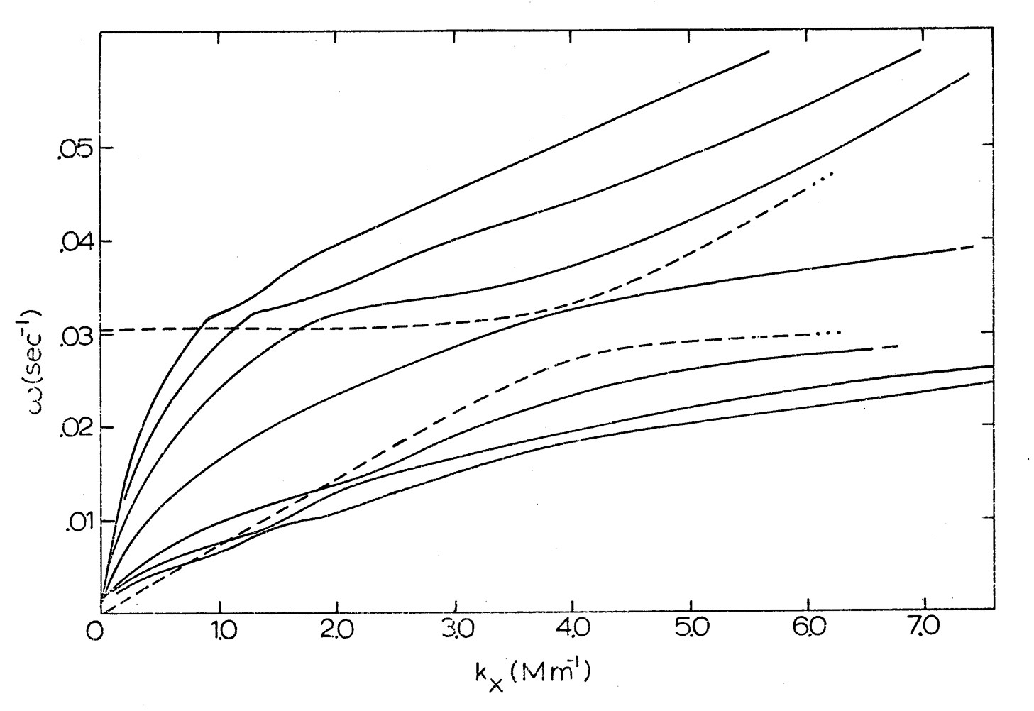
Modes of piecewise linear temperature atmosphere
Leibacher, thesis
1971

Slide 17
Modes Observed – Franz Deubner

Slide 18
Toy Model
Resonance condition:
Dispersion relation:
Atmosphere:

Slide 19
Low l modes
i.e. s=ω/k_{H}
Notes:
Propagate in interior where temperature and sound speed vary slowly, but s[herical effects are important.

Slide 20
High l Modes
i.e. S=ω/k_{H}
Notes:
Z= depth
Confined to the near surface where temperature and square of sound speed increase linearly with depth, but spherical effects small because r≈R.

Slide 21
Mode Excitation
Convective Excitation(earliest idea)
  Granule pumping
  Lighthill Mechanism
Overstability
  Κ-mechanism
  Thermal overstability
Stochastic excitation by convective turbulence
  Reynolds stresses
  entropy fluctuations

Slide 22
Granule Pumping
Overpressure in granule produces sound waves
Notes:
Problems: Size of oscillating regions larger than granules, no observed correlation with granules, lifetime of individual oscillations longer than granules
:

Slide 23
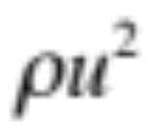

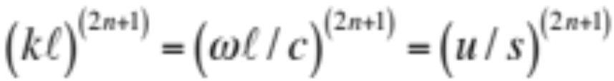
Lighthill Mechanism
Rate of acoustic energy generation is
turbulent energy density
  ÷ turbulence time scale
  × efficiency factor
In absence of external forces (gravity) turbulent eddies are incompressible and isotropic, so emission is quadrupole
In stratified medium also have monopole & dipole emission
Lighthill 1952; Moore & Spiegel 1964; Unno 1964; Stein 1967; Musielak 1994
Notes:
Problems: frequency too high, period ~ 20-60 sec << 300 sec.

Slide 24
Thermal Overstability
Mechanism:
instability which drives system away from equilibrium.
Restoring force that brings system back to equilibrium.
Process that reduces the driving force or increases the restoring force.
Acoustic wave is compressed as it moves downward into hotter surroundings, so it gets heated and its pressure increases which makes it expand more.
Spiegel 1964; Moore & Spiegel 1966; Ulrich 1970; Chitre & Gokhale 1975;
Jones 1976; Graff 1976

Slide 25
Kappa Mechanism
Compression increases temperature -> opacity
Radiation gets trapped -> heats gas
Pressure increases -> greater expansion
Expansion decreases temperature -> opacity
Radiation escapes -> cools gas
Pressure decreases -> greater compression
Ando & Osaki 1975; Goldreich & Keeley 1977; Christensen-Dalsgaard & Frandsen 1983;
Balmforth & Gough 1990; Balmforth 1992
Conclusion: p-modes are likely stable
Notes:
Problem: difficult calculation, much disagreement amoung authors

Slide 26
Stochastic Excitation
Convective Reynolds Stress & Entropy Fluctuations can drive acoustic waves
Lighthill formulation does not work inside source region, needs generalizing to include mode properties.
Can be expressed as PdV work by non-adiabatic pressure fluctuations on mode compressibility.
Goldreich & Keeley 1977; Goldreich & Kumar 1990; Balmforth 1992; Goldreich, Murray & Kumar 1994; Nordlund & Stein 2001; Stein & Nordlund 2001; Samadi & Goupil 2001; Stein et al. 2004; Chaplin et al. 2005; +

Slide 27
Modified Lighthill Mechanism
Replace arbitrary displacement in the inhomogeneous wave equation with the oscillation eigenmode displacement.
Balmforth 1992; Goldreich, Murray & Kumar 1994; Samadi & Goupil 2001; Chaplin et al. 2005

Slide 28
PdV Work
The PdV work is
so the work integral is
This can be evaluated to obtain the rate of mode excitation
The mode energy E_{ω} is
and the non-adiabatic pressure fluctuations are
This is similar to the results of Balmforth 1992, Samadi et al. 1993 & Goldreich, Murray & Kumar 1994 except that neglect the phase between the pressure fluctuations and the mode compression by taking the square of each independently.
Usually these formulae for mode excitation are evaluated using simple models of convection. However, they can be evaluated exactly using results of convection simulations.

Slide 29
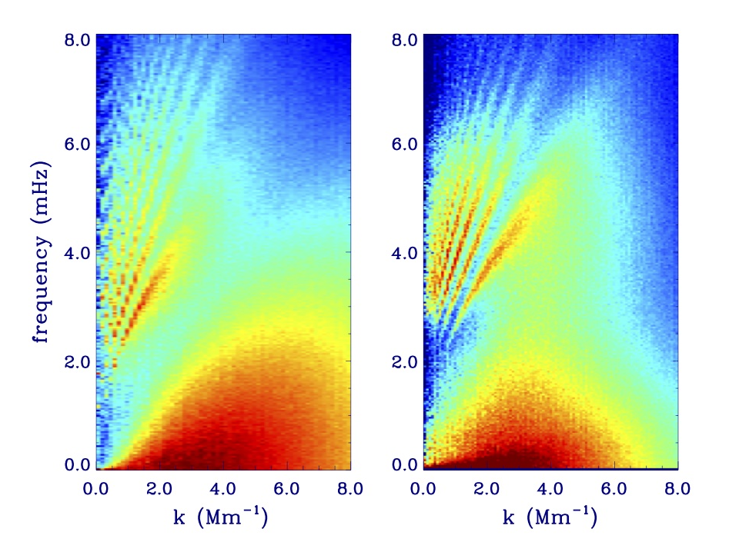
simulation
Hinode

